Slide 1
Year 11 Exam Information Evening Thursday 24th October 2024

Slide 2
Mr Wheel Head of 6th Form
6th Form Transition

Slide 3
Making Choices
What do I enjoy?
What is my passion?
What entry requirements am I likely to meet?
Start with…
Where could these subjects take me?
Do these subjects complement each other?
What do my teachers think?
Notes:
Before we start promoting our Sixth Form Open Evening – we want to talk to you about your choices and the thought process around the choices that you make.
Some of you

Slide 4
A Level
Combined
Vocational
3 or 4 A Levels &
Optional EPQ qualification
A combination of A Level and Vocational subjects
3 Level 3 applied courses
Pathway
5 Grade 5 – 9, including English and Maths &
subject specific requirements
5 Grade 4 – 9, including English and Maths &
subject specific requirements
5 Grade 4 – 9, including English and Maths &
subject specific requirements
Requirements
University, including (Oxbridge, Russell Group, Medicine), degree apprenticeship and employment
University, degree apprenticeship and employment
University, degree apprenticeship and employment
Destination

Slide 5
Level 3
Art
Drama
IT
Photography
Sport
Art and Design
English Lit
Maths
Physics
Travel and Tourism
Biology
French
Core Maths
Psychology
GCSE English
Business
Geography
Further Maths
Applied Science
GCSE Maths
Chemistry
Health and Social Care
Media
Sociology
L2 Health and Fitness
Criminology
History
Music Tech
Spanish
L2 Applied Science

Slide 6
Local Picture for Post-16
A-Levels
Vocational
Disadvantaged students are averaging a Dist across vocational subjects compared to Dist – in local Authority and England.

Slide 7
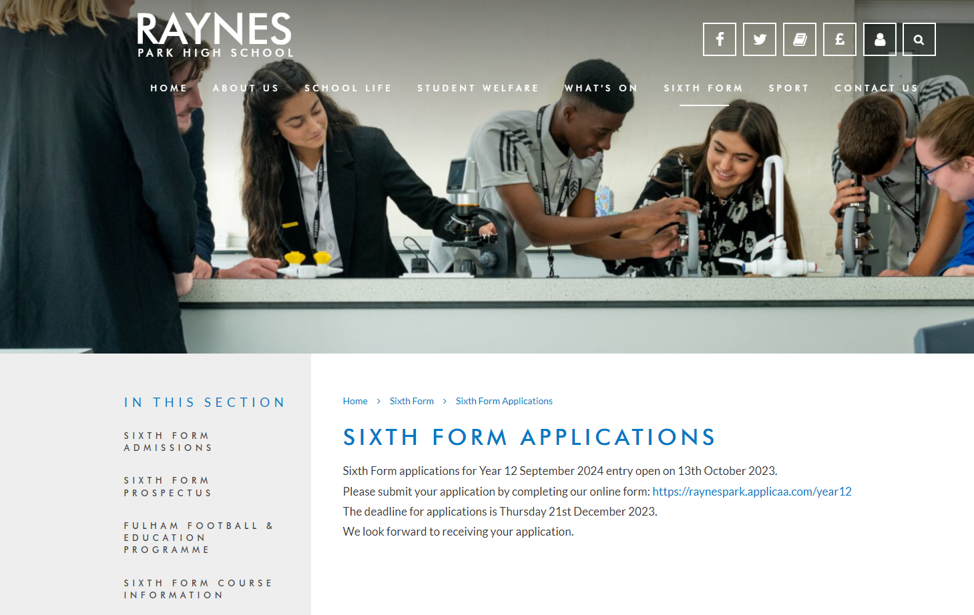
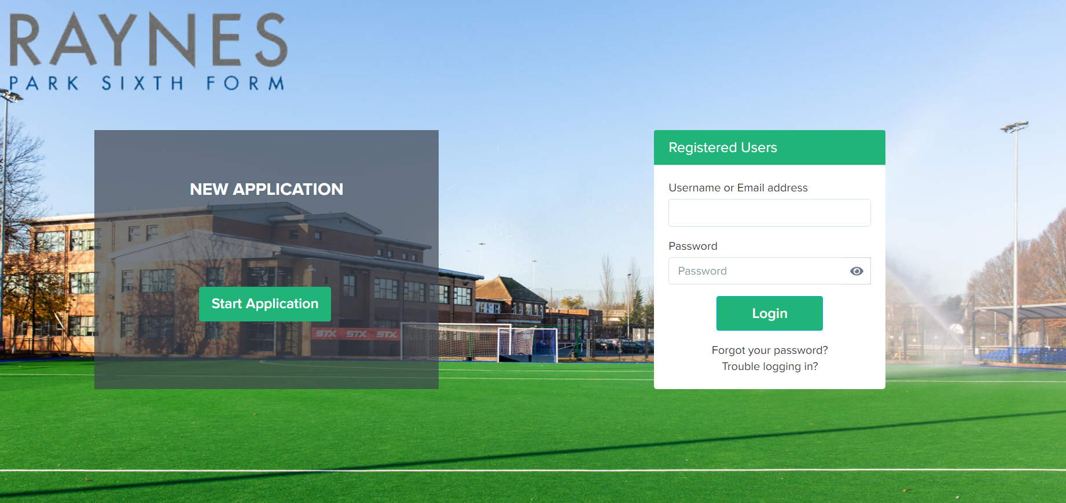
How to apply
Raynes Park High School Website – Sixth Form
Now – 20th December 2024
Applications should be made using the link sent to students school email address
January onwards – Guidance Meetings

Slide 8
Mr Hogarth Deputy Headteacher
The importance of getting it right in Year 11

Slide 9
Context
The students started school at approx. age 5
They have been “in school” for approx. 11 years of their life – nearly 450 school weeks
They have been working towards one goal – their GCSEs this summer
The results they receive in August will determine their future pathways and the opportunities available

Slide 10
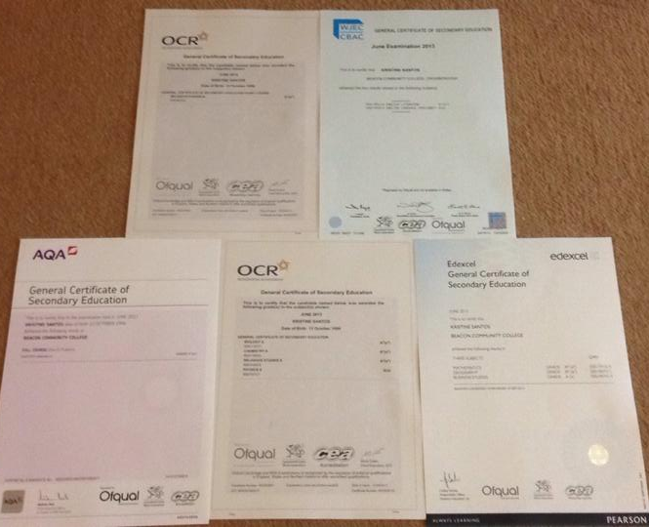
The grades that appear on your certificates will open doors for your future choices – make the most of your time to ensure those choices are plentiful!

Slide 11
Impacts of not getting the grades ….
6th Form Entry requirements:
5 x 9-5 (including E and M) to be eligible for A Levels
Some A Levels have entry criteria e.g. 7’s in Maths, Science etc.
Minimum of 5x 9-4 (including E and M to study post 16
Legal Requirements:
Students will have to retake English and / or Maths until they pass or become 18
This will affect employment / apprenticeships – they will want you to have passed otherwise you have to go to college
Please note that GCSEs are Level 2 qualifications.
Level 2 post 16 is not progress these are GCSE equivalents.
Most students will start Level 3 qualification after school.
Be aspirational!

Slide 12
Education Pays
Average Salary 5 Years after Graduation (aged 24ish)
– Just some examples – These are not the highest!
University of Nottingham £40,000
UCL University College London £40,600
Loughborough University £40,500
University of Leeds £40,400
Bristol University £41,000
University of Warwick £42,500
Aston University £43,000
University of Bath £43,500
Durham University £45,000
University of London £45,500
No.1 = London Business School @ £70,000 per year!
Approx. 10K more than the average wage and these salaries will only increase with experience / promotions etc
Median annual pay for full-time employees was £33,000 for the tax year ending on 5 April 2022 (Office of National Statistics)

Slide 13
Education Pays
0.012%
£40-45,000 is higher than the majority of the players playing League Two football at clubs like….
Sutton United
AFC Wimbledon
MK Dons
Notts County
Wrexham
Swindon Town etc.
This is the percentage chance of a boy that currently plays organised football (there are 1.5million) playing 1 minute in the Premier League

Slide 14
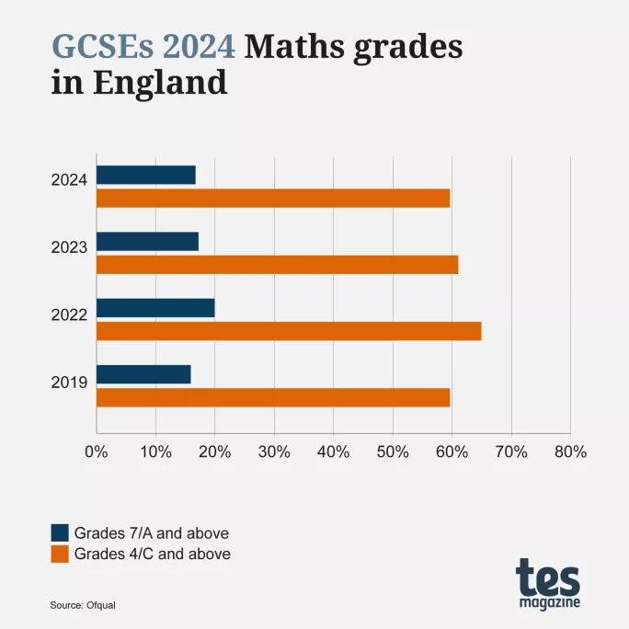
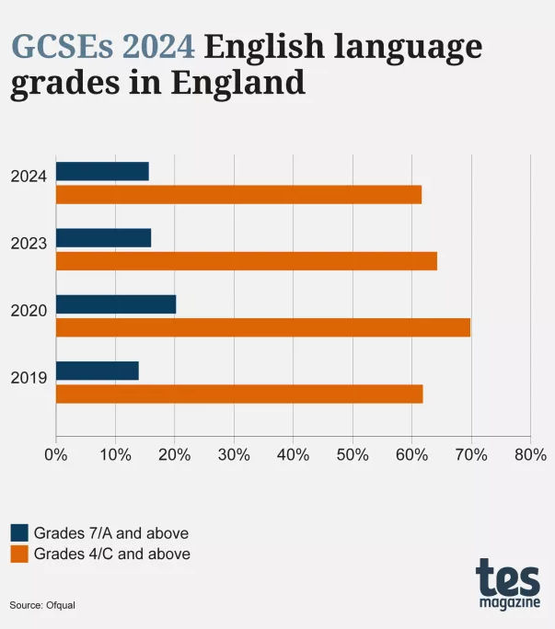
The best time is now ……
Don’t bank
on a retake!
The national average pass rate post 16 is ….
English – 20%
Maths – 17%
80%+ will fail again!

Slide 15
Mr Jones Senior Teacher
Exams – What to expect

Slide 16
Why are we here?
To share the journey ahead over the next 6 months (22 School Weeks)
To support you in supporting our students
Preparation for the mocks x2
Preparation for Summer exams – Starts in May
Dealing with the stress / pressures of Year 11
To share the support on offer
To work together to achieve the best outcomes for our young people

Slide 17
Key Dates
ID1: 17th October 2024
Revision Conference: 18th October 2024
Autumn Half-Term: 28th October 2024
Mock Exam Window 1: 5th – 15th November 2024
ID2: 28th November 2024
Parent/Carer Evening: 9th January 2025
Spring Half-Term: 17th February 2025
Mock Exam Window 2: 3rd – 14th March 2025
ID3: 27th March 2025
GCSE Exam Window Opens: 6th May 2025
Summer Half-Term: 26th May 2025
GCSE Exam Window Closes: 20th June 2025
GCSE Results Day/6th Form Enrolment: 21st August 2025

Slide 18
What to Expect: Mock Exams
Two week period of Mock GCSE Exams
Exam conditions with appropriate concessions for eligible students
Exams to take place P1, P3 and P5
In the Sports Hall – mirroring GCSEs
Official results assembly
Results will inform projections, intervention strategies and tiers of entry
Restrictions on toilet breaks

Slide 19
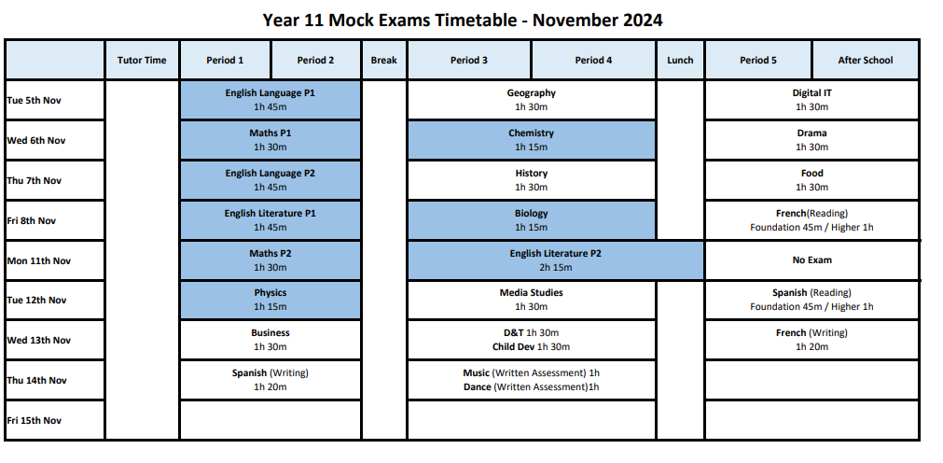
Mock Exam Timetable

Slide 20
What to Expect: GCSEs WB: 6th May
Exams to take place in Sports Hall
Uniform and equipment to be perfect
Official exam invigilators
Morning exams- 9am start
Afternoon exams- 1.30pm start
Drop down sessions prior to exam
Smaller rooms for eligible students with concessions

Slide 21
Rules: Mocks and GCSEs
Students are under exam conditions starting from the line up
Silence at all times – no communication
Phones switched off and in bags at the front of the hall and no watches or other tech to be worn
Clear pencil cases and water bottles with no labels
Uniform is to be perfect
You will have the same seat for all of your exams- numbered and lettered
If you are late you risk not being able to enter the hall
No toilet break unless medical evidence is provided

Slide 22
What will happen in the Summer?
6th May 2025 is the start of the GCSE exam window
We will provide all students with:
Exam breakfasts
Drop down days before exams
Continuation of study space and resources
No study leave- we want you in school in as many lessons and drop downs as possible
Exams, lessons and drop downs for 5 weeks
20th June is the end of the GCSE exam window
GCSE results day 21st August 2025
6th Form enrolment

Slide 23
Mr Jones Senior Teacher
Preparing Students
for Exams

Slide 24
How can you help?
Monitor your child’s revision at home
Support with creating a timetable around existing commitments
Motivate your child when it gets difficult
Provide a quiet space to revise
Provide resources when necessary
Ensure your child is in school every day

Slide 25
Attendance is the key to success
Our expectation is for students' attendance to be 96% +

Slide 26
Attendance
Attendance to school is not enough
Attendance to Period 6, drop down days, half-term intervention and tutor time English/Maths sessions is paramount
Do not just ‘turn up’ and go through the motions
You must be present at all times and giving 100% effort in all of your timetabled lessons

Slide 27
Intervention
Extensive programme of Period 6 or Tutor Time Intervention
Intervention timetable is flexible and will need accountability from students
Half-Term/Easter Intervention to be confirmed
IT6 is open daily from 3-4pm for extra study (Monday to Thursday)
Timetabled Intervention is compulsory

Slide 28
Subject Intervention Timetable
 | Monday | Tuesday | Wednesday | Thursday | Friday
AM | Maths | Maths | Maths | Maths Dance | English Maths
PM | English Geography IT | DT Food | History Media | MFL PE | Business Drama

Slide 29
What we have provided for you..
Excellent lessons/teaching
Sparx Maths and Educake
Your teachers’ support
Feedback – classwork and mock exams
Intervention- Period 6, Tutor Time and Holidays
Revision Conferences
Drop-Down Sessions
Pupil Progress Learning Reports
Learning Checklists and Revision Resources
Homework club and Study Space in IT6

Slide 30
How Prepared are you for learning?
How to be prepared for learning:
Equipment
Books
Attitude
Organisation
Attendance / Punctuality
Sleep
Nutrition and Hydration

Slide 31
Revision Starts Now
Students are studying for 9 GCSEs
We have approx. 100 school days left
That is only 11 “after schools per subject”
Help students to produce a revision timetable to ensure that they cover all of the content before the summer
Use the template provided if that will help
Help the students to stick to their plan

Slide 32
Revision Starts Now
You should be doing revision most evenings and at the weekends
During the School Holidays you will need to be revising
After the Mock Exams you will need to continue revising and doing past exam papers – see exam board websites or your teachers
Use the feedback from the mocks to identify your areas of weakness – work on these most

Slide 33
Past Papers
Practice Papers v KS2 Prior attainment
The number of practice papers you do is a better indicator of what you will achieve than your KS2 prior attainment:
Make sure you do as many past paper questions as possible*
Past papers can be found on the Internet and with class teachers
Links to exam boards can be found on the school website
Practise highlighting questions and planning answers
Time yourself to match the number of marks available
Use mark schemes to correct your answers
You need to redo bits of the questions you have scored badly in
You can repeat exam questions

Slide 34
Why do you need to make revision notes?
What do people remember?
10 percent of what they READ
20 percent of what they HEAR
30 percent of what they SEE
50 percent of what they SEE and HEAR
70 percent of what they SAY and WRITE
90 percent of what they DO
The best way to revise is to READ the information, SAY it out loud, WRITE it down and then DO (complete a practice question with that information). Then REPEAT this some time later.

Slide 35
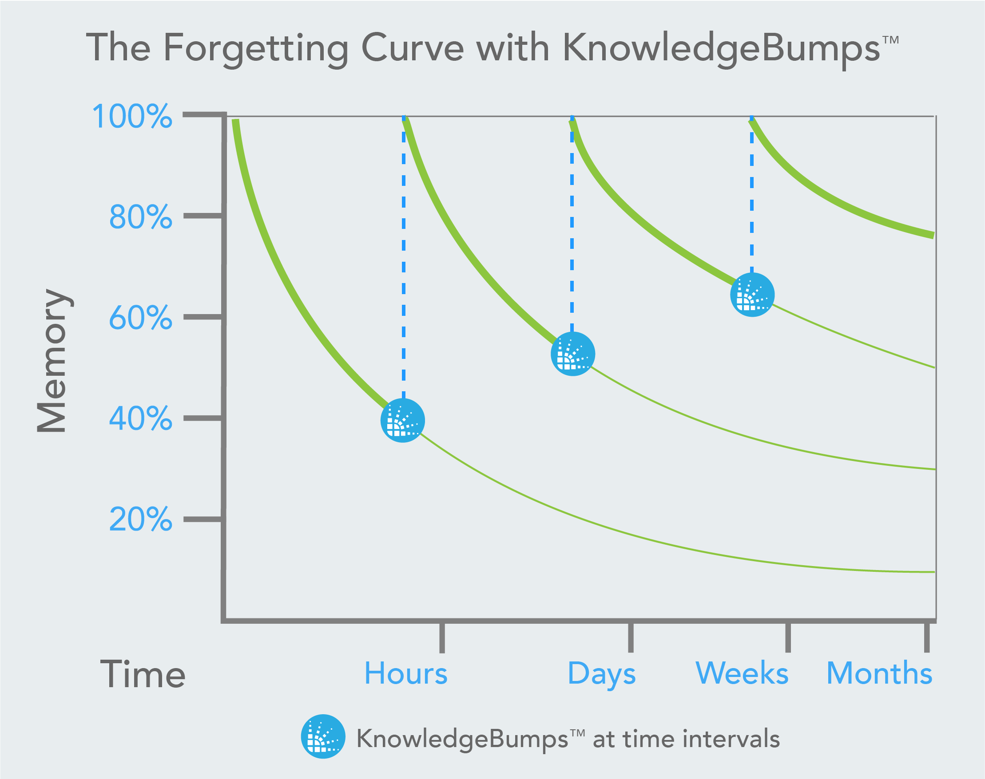
Why do you need to make revision notes?
Notice how more information is retained after each knowledge review.
This is why we do “Retrieval Starters” in our lessons and why revision is so important for success

Slide 36
How to revise?
Revision Timetables
You will need a ‘school time’ revision timetable for evenings and weekends
You will also need a revision timetable for the holidays
Your revision timetable should be manageable and reflect your subject priorities
Your revision timetable should provide time for rest, food and exercise

Slide 37
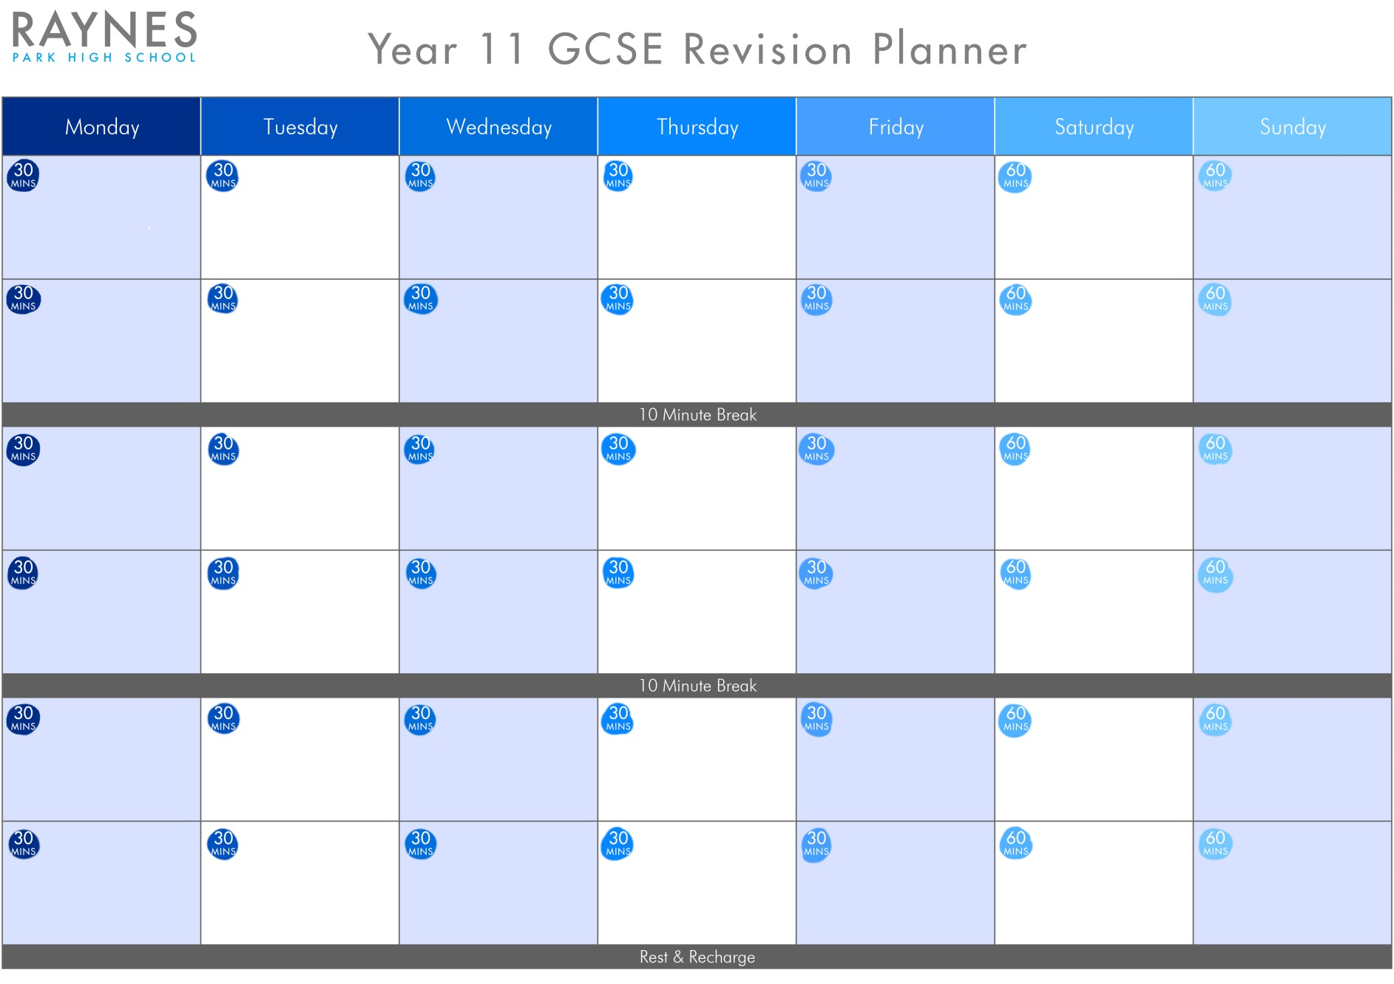

Slide 38
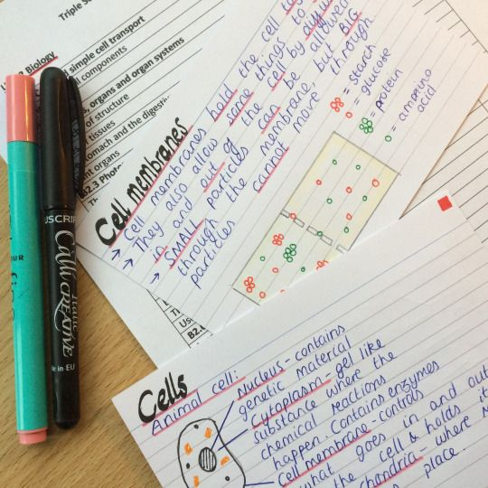
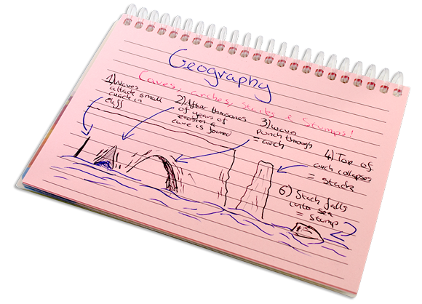
Flash cards
WHEN
WHAT
HOW
WHY
IMPACTS
KEY WORDS
Use bullet points
Divide your page up
Highlight/underline important concepts/terms
Use different colour pens
Use the same format
Make them legible and easy to understand

Slide 39
Leitner System

Slide 40
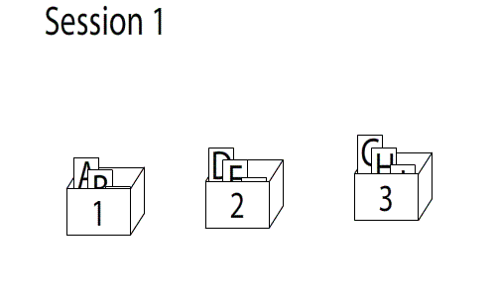
Leitner System

Slide 41
‘Post it’ notes – when and how to use them
‘Post it’ notes are a useful way to record small but important bits of information, that you want to refer to frequently
‘Post its’ are good for recording
and learning quotes
Use ‘post its’ to annotate
revision guides, mind maps
and notes
Use different colours
For each subject
‘Post its’ are useful
for equations or scientific
formula
Display them in places
you often visit
Use them for learning small but important facts

Slide 42
Mind maps

Slide 43
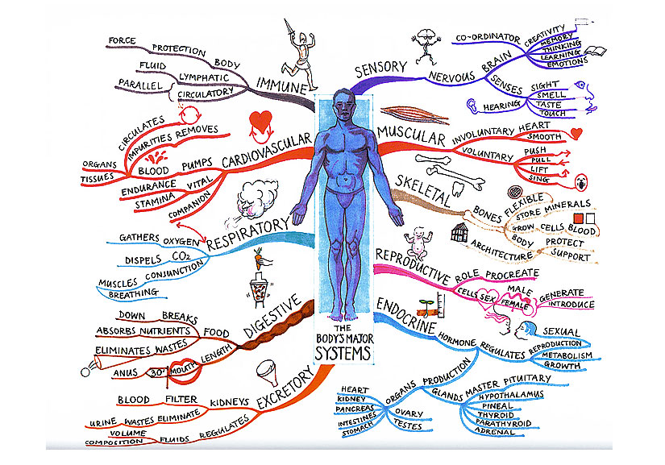
Advantages of mind maps
Mind maps
allow you to break
down subjects into
smaller topics
Mind maps provide
excellent visual stimulus
Mind maps are
more fun to create
Mind maps make revision more interesting
and allow knowledge to be compartmentalised

Slide 44
Cornell Notes
Title/Heading of Topic
Key Terms Questions 30% | Main Notes *Ideally using abbreviations Key Thoughts 70%
Summary

Slide 45
Mr Bartlett Head of Year 11
Healthy Routines

Slide 46
Setting Goals
Help focus them and talk to them about their goals regularly
Give positive reinforcement
Talk to them about ‘what’ they want to achieve and ‘how’ they can do that
Keeping Active
60 minutes per day
Encourage them to keep active every day
Make plans to do something together at the weekend
Exercise helps your brain to function so start revision session afterwards

Slide 47
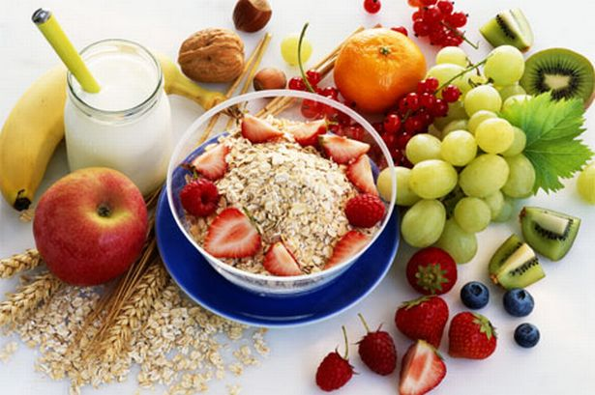
Healthy Eating
Encourage them to eat breakfast everyday
Try to ensure they have a healthy diet
Hydration is key to brain functioning so make sure your child carries a bottle of water with them
Time Out
Encourage them to take some time out every week doing things they like to do e.g. Seeing friends, listening to music or hobbies

Slide 48
Good Sleep Patterns
Between 8 – 9 hours sleep per night
Help create a relaxing evening routine
Make sure they don’t work or revise too late before going to bed
Unplugging
Help them switch off from technology at least 30 mins - 1 hr before going to sleep
Support your child to appreciate the world around– mindfulness
Make sure they put their phone away, & on silent, while they are revising
Choose time each day/week to switch off and unplug from technology with them

Slide 49
Staying Cool & Calm
Try to set a good example by staying calm yourself
Create a relaxing environment for your child
Help them plan out coping strategies to deal with their stress
Help them understand their stress & to focus on controlling the controllable

Slide 50
Belief
Give them positive reinforcement to boost their confidence
Celebrate any successes and reward them e.g. if they have achieved their mini-goals
Try not to set your expectations too high
Show them how proud of them you are
Highlight things to make them feel good
Give them the belief in themselves to help them achieve

Slide 51
Be Supportive
Be a good listener
Encourage them to take breaks in between revision
Show some understanding of what they are going through
Help them deal with their emotions & feelings
Offer caring advice
Just be there for them!

Slide 52
Students to leave Main Hall and make their way to the Canteen
Parents/carers, please remain in the Main Hall

