Slide 1

YEAR 8 & 9 PARENT INFORMATION EVENING Thursday 11th September 2025

Slide 2
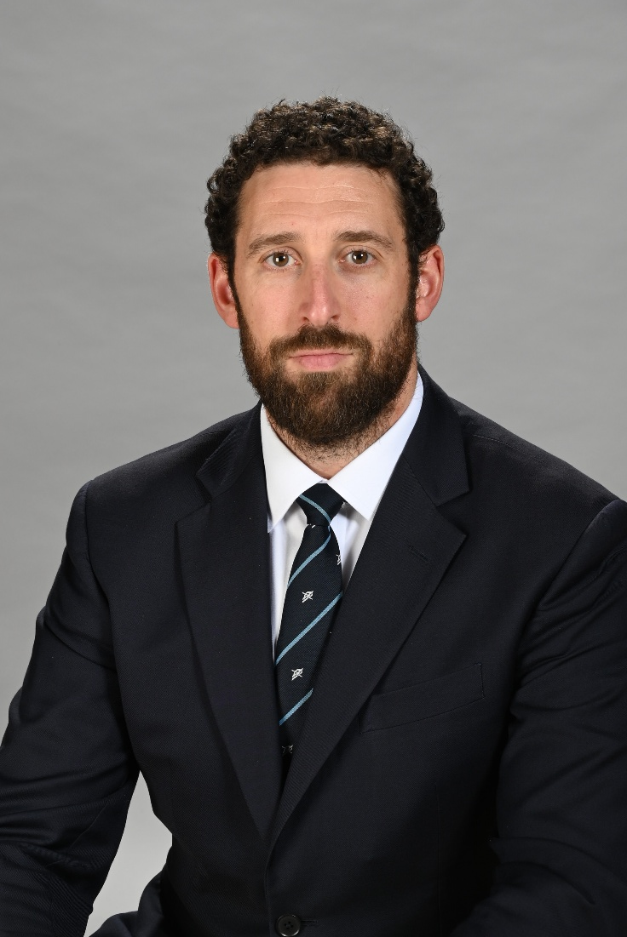
Attendance, Progress and Standards
Mr Mc Inerney, Deputy Headteacher, Raising Standards: Behaviour

Slide 3
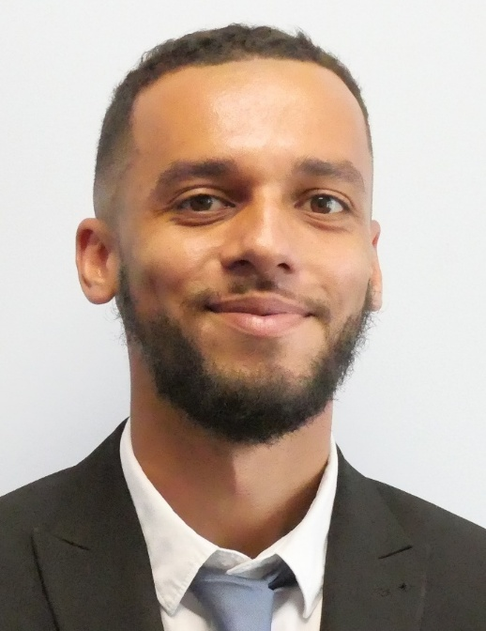


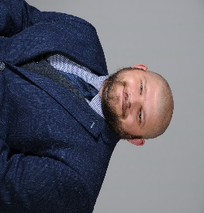
Key Year 8 and 9 Staff
Mr Bartlett
Head of Year 8
Ms Crossfield
Head of Year 9
Ms Pocentek
Deputy Head of Year 8
Mr Ayre
Deputy Head of Year 9

Slide 4
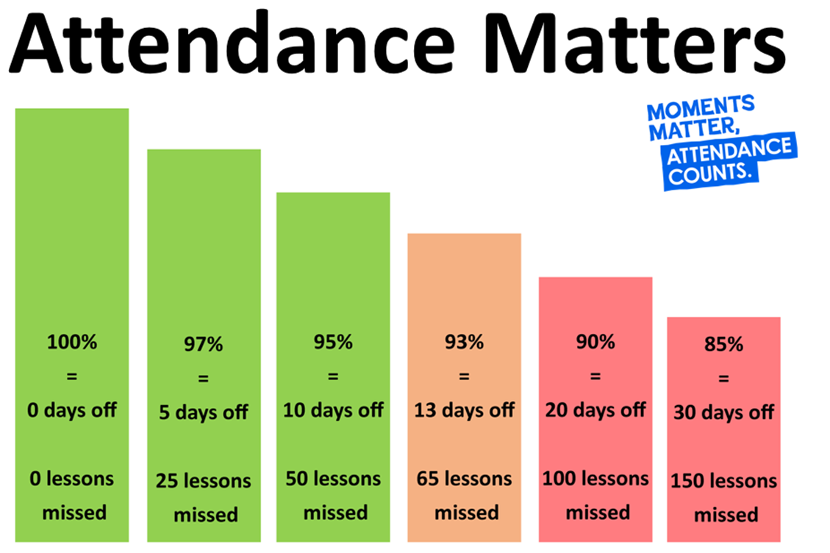

Slide 5
How Attendance Affects Results…
Year 11 exams –
Over 90% Attendance
English and Maths
4+ - 76%
5+ - 62%
Year 11 exams –
Below 90% Attendance
English and Maths
4+ - 52%
5+ - 32%

Slide 6
How Attendance Affects Progress…
Primary
Secondary
Positive progress 8
Expected progress 8
Negative progress 8
Year 1 Year 2 Year 3 Year 4 Year 5 Year 6 Year 7 Year 8 Year 9 Year 10 Year 11
Progress 8 –
Over 90% Attendance
+1.28
Progress 8 –
Under 90% Attendance
-0.13

Slide 7



Slide 8

School Values
Classroom Expectations
Line up outside classrooms & be met by their teacher
Sit in the seating plan that is built to support students
Stand behind desks at start and end of lessons
Always be sat up and paying attention
Planners, pencil cases and reading books out
Wear their blazers at all times around school
Display a positive attitude to learning (AtL)

Slide 9
School Values
Social media
Mobile Phones
School Uniform

Slide 10
Community
Lining up outside the gate
Changeover (Playground – no congregating)
No physical contact at break
Toilets
Lime bikes
Energy drinks
Supporting our reputation in the community

Slide 11
Systems for Success
Line ups
Year group tutor bases
Tutor Time Reading Program
Year group break areas
PE kit on PE and dance days
Our one way system
Extra curricular clubs and activities
Enrichment

Slide 12
School Contacts
Pastoral
Form tutor
Academic
Class teacher
Deputy Head of Year
Head of Department
Head of Year
Mr Hogarth
Deputy Headteacher
Assistant Headteacher
Mr King /Mr Mc Inerney
Deputy Headteacher

Slide 13
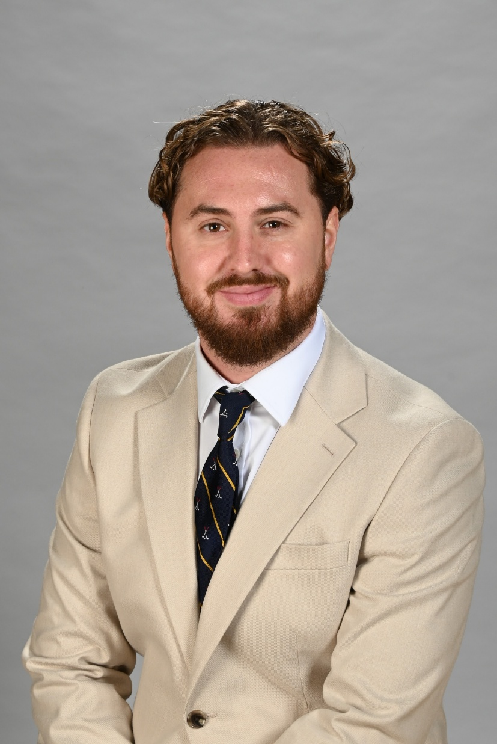
Curriculum and Homework
Mr Jones, Senior Teacher, Raising Standards and Behaviour Support

Slide 14
The RPHS Curriculum
We are very proud of our broad and balanced curriculum here at Raynes Park
It is supported by an extensive extra curricular programme
Our Heads of Department continue to examine their curriculum areas to identify what the essential knowledge and skills to be taught are
Students are given regular low stakes assessments alongside more formal tests and exams to identify gaps and inform planning
Intervention and support is targeted at students where they need it most

Slide 15
KS3 (Yrs 7-9 Curriculum
Subject | Periods | Minutes
Maths | 4 | 240
English | 4 | 240
Science | 4 | 240
PE | 2 | 120
DT | 1 | 60
Geography | 2 | 120
History | 2 | 120
MFL (French/Spanish) | 2 | 120
Computer Science / ICT | 1 | 60
Art | 1 | 60
Dance / Drama / Music (Rotation) | 1 | 60
Learning 4 Life | 1 | 60
Totals | 25 | 1500

Slide 16
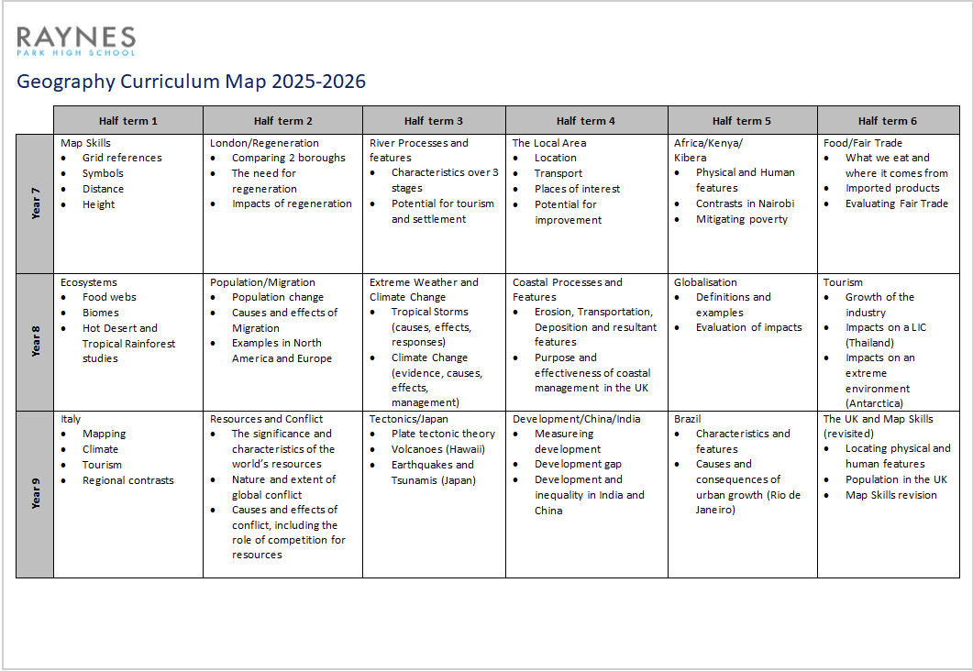
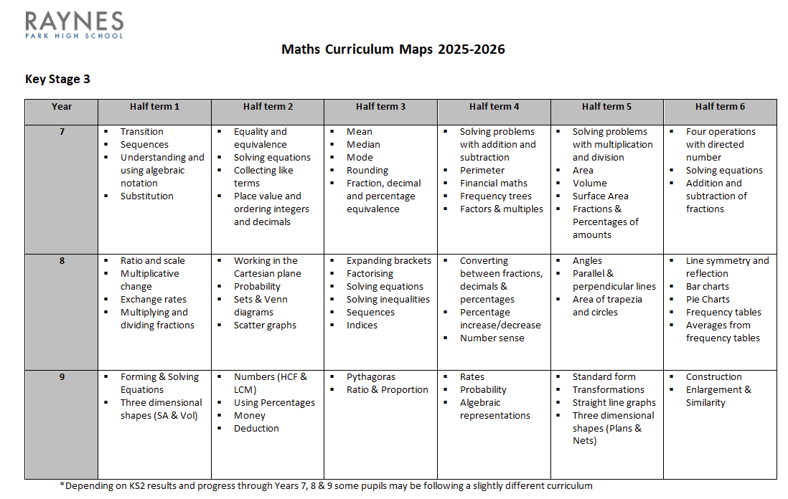
Curriculum Information Booklets

Slide 17
Assessment and Reporting
Regular Report Cards – x3 (one per term)
Academic Progress and Attitude to Learning – L.E.A.R.N.
Attitude to Learning is Assessed for both School Work and Homework
House Points
Attendance
Punctuality
Subject / Parents Evenings
Academic Target Setting and Review days

Slide 18
L | Exceptional | Learner is highly self-motivated Excellent co-operation and awareness of others Respectful of others and voluntarily assists them when it is required Work is completed to a standard far exceeding expected ability Always on time Meets all deadlines
E | Exceeding | Expected effort always exceeded Always co-operative with staff Always respectful Work is complete to a standard exceeding expected ability Always on time Meets all deadlines
A | As Expected | Allows teaching to take place uninterrupted Makes expected effort Co-operates quickly Respectful of others Completes work to a standard in line with expected ability Completes work on time
R | Below Expectations | Due to one or more of the following; Occasional low level disruption Effort can be inconsistent Variable engagement in learning activities Slow to co-operate Can be late to lessons Working at a standard below ability Sometimes fails to meet deadlines
N | Needs to Improve | Frequent disruption to lessons Minimum effort made Disengaged from learning Lacks co-operation and / or Often disrespectful Frequently late to lessons Working at a standard far below expected ability Fails to meet deadlines
Attitude to L.E.A.R.N. ing

Slide 19

Homework – Satchel One
All homework is communicated via Satchel
This can be tracked using the App or via the website
Some subjects use other online platforms too:
English – Educake
Science – Educake
Maths – Sparxx Maths
Just as important as classwork to consolidate learning, practice skills and to apply knowledge

Slide 20

Homework – Satchel One
Can be accessed via an App (available on Android and IOS)
The Satchel Website for our school is - https://raynespark.satchelone.com/school/home
This can be quickly accessed via our school homepage

Slide 21
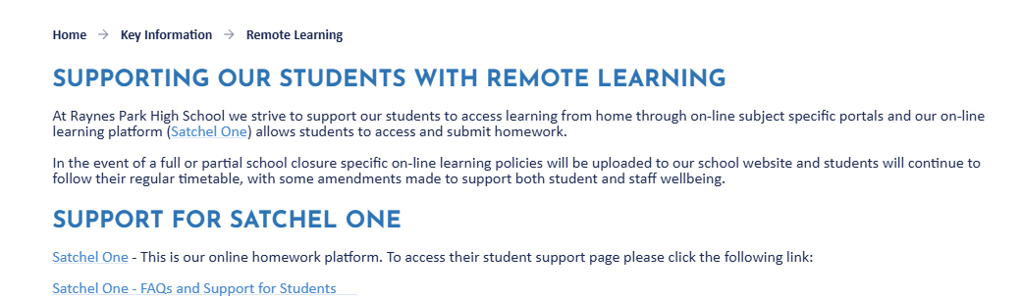
Homework – Satchel One
Should you need any support with Satchel please visit the Remote Learning section of our website

Slide 22
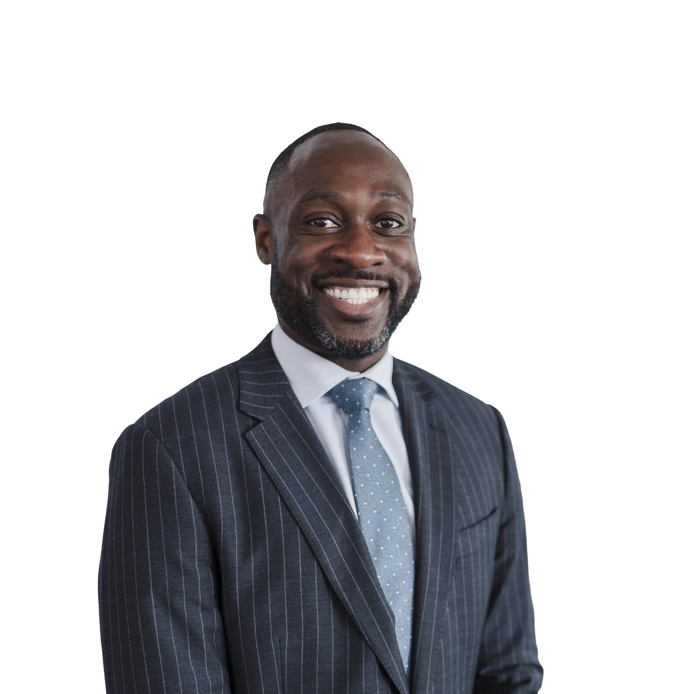
RSHE+C and Careers
Mr McCurdy, Assistant Headteacher, Raising Standards: Post 16

Slide 23






Why RSHE+C Matters in Schools
Develop life skills and knowledge
Safety
A safe space to talk
School culture and behaviour

Slide 24

Statutory Requirements in
Secondary Education
From 2020, Relationships and sex Education became compulsory in all secondary schools
A new focus in the requirements was on supporting young people to have healthy and consensual relationships (previously, only sex education was compulsory and was covered mainly in Science)
New research shows just how widespread exposure to misogyny or harmful online content has become

Slide 25
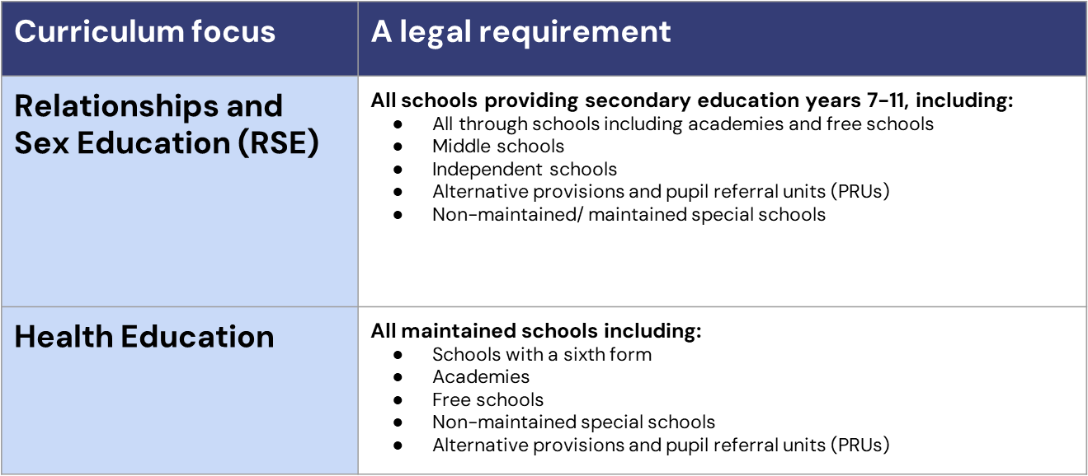
Statutory Requirements in
Secondary Education

Slide 26
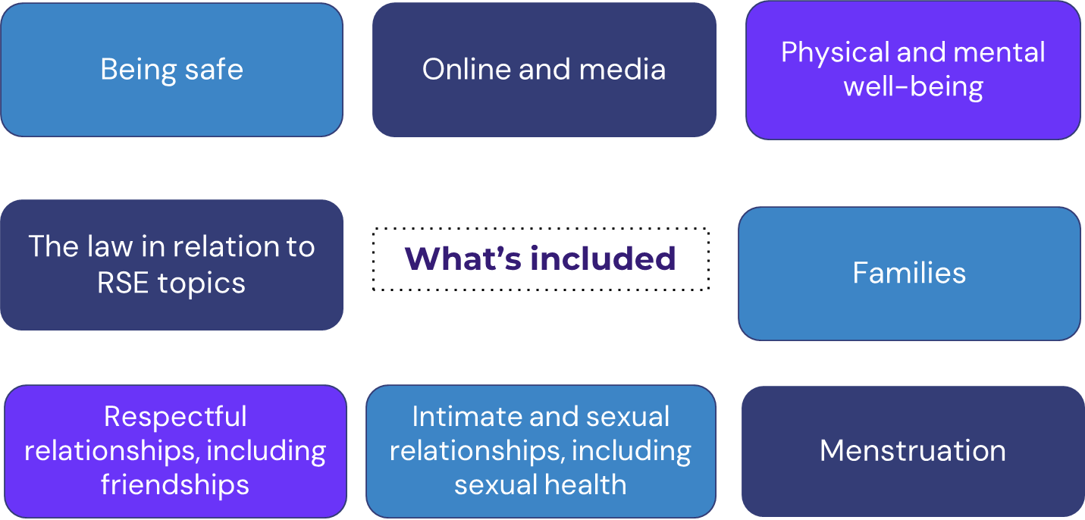
Areas of Focus

Slide 27

RPHS Resources

Slide 28
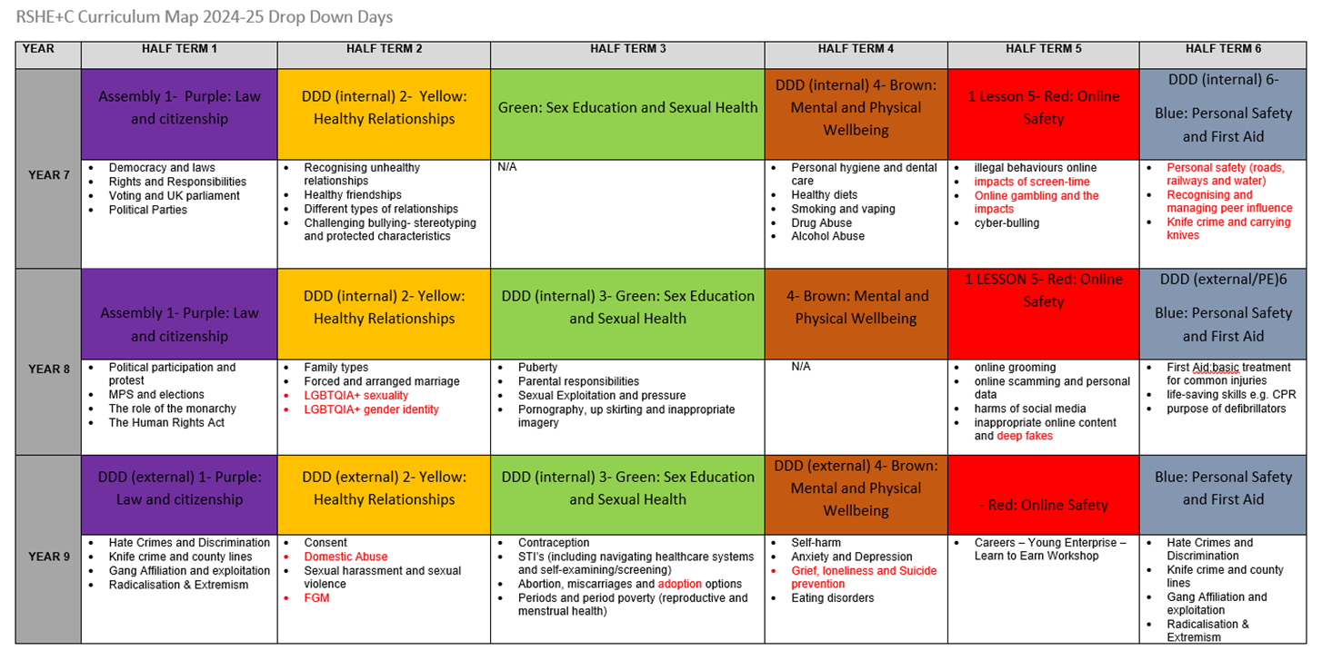

Slide 29
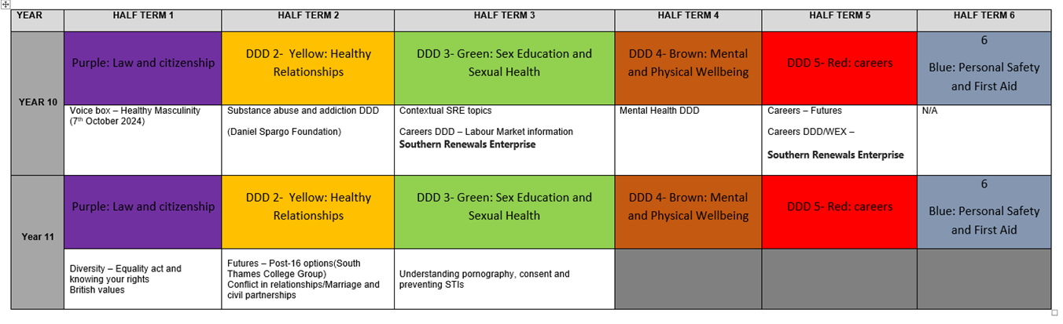

Slide 30
Age Appropriateness
We are sensitive in our approach in teaching topics at a time that will most benefit the safety and development your child.
The influence of other people including friends and older siblings
Access to technology and the world of adult focussed content it opens up
Spiralled curriculum
SEND
Neurodivergence

Slide 31
How to Support your Child in their
RSE Journey
*Our Recommendations*
Celebrate individual differences to promote a greater sense of belonging for everyone in society
Talk openly with your child to model confidence in discussing tricky topics
Listen to your child without judgement
Engage with the school’s parent consultations about RSE topics
Stay up to date with what is being taught and when so you can follow up on these topics at home
Ask for support if you need it - you are not expected to know everything!

Slide 32
New Updates
Why?
Children are increasingly exposed to harmful content online, including misogynistic attitudes and unhealthy views about relationships.
What?
In secondary school, all students learn about consent, and lessons focus on helping teenagers understand consent as well as kindness and respect as they’re getting ready for more intimate relationships.
Students will learn to identify positive role models and understand how to challenge harmful attitudes they might encounter online.
How?
Teachers will receive proper training to handle these sensitive topics effectively.

Slide 33
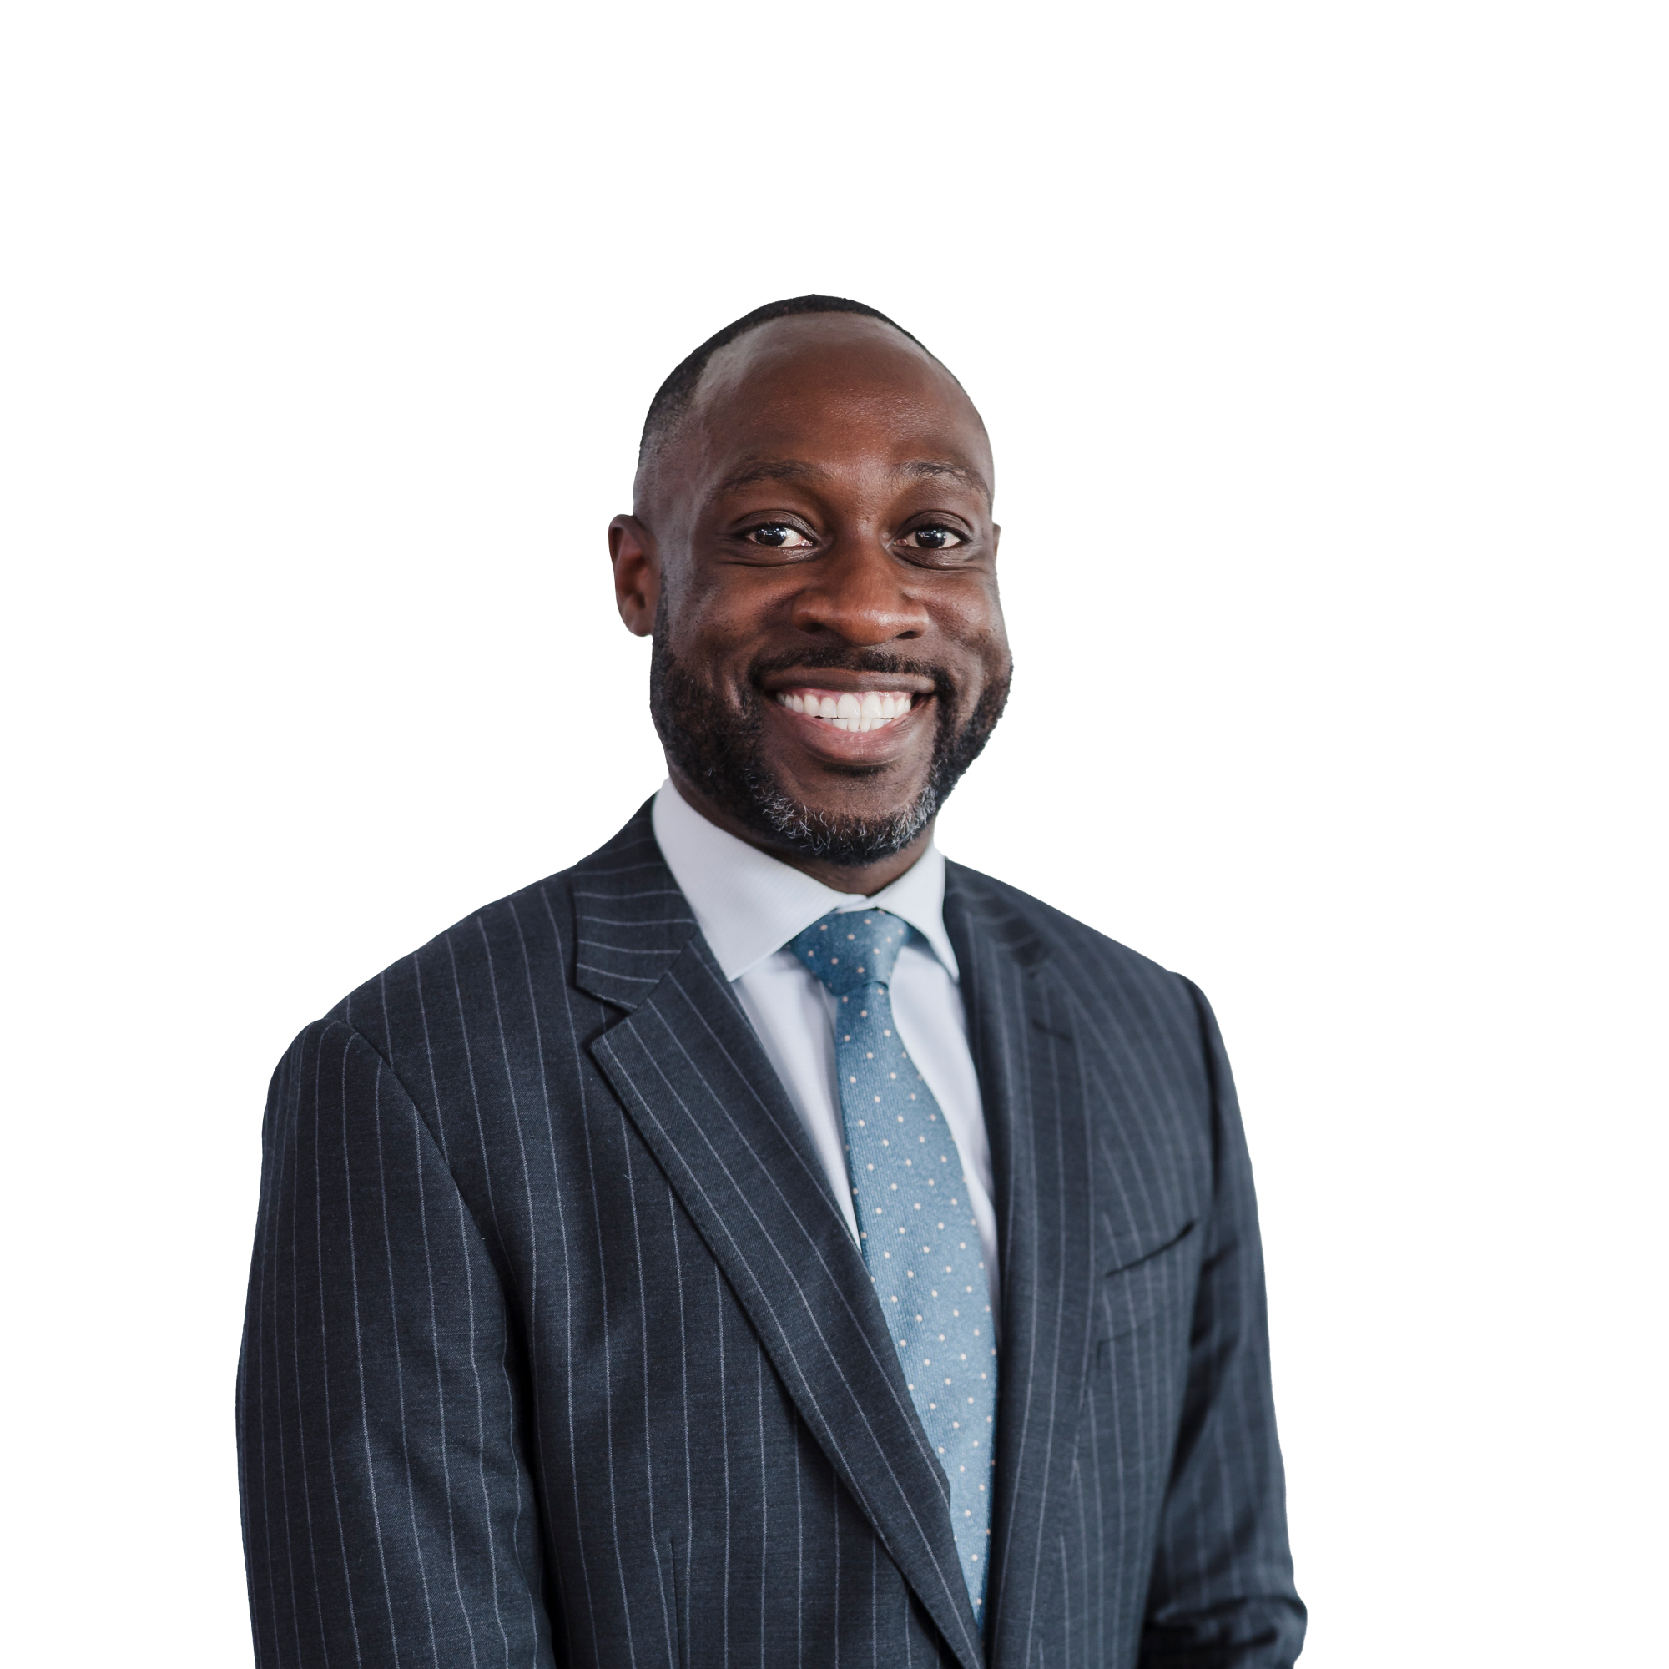

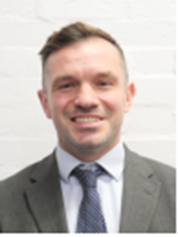
Ongoing Support
Miss Yusuf
Wellbeing Manager
Mr Nash
Assistant Headteacher:
Safeguarding & DSL
Mr McCurdy
Assistant Headteacher: PD
Click here (https://www.rphs.org.uk/attachments/download.asp?file=333&type=pdf) to view our RSHE policy
If you have any questions about the topics your child is learning, please contact the members of staff below

Slide 34
Safeguarding and Online Safety
Mr Nash (DSL), Assistant Headteacher, Raising Standards: Keeping Children Safe in Education

Slide 35
A Culture of Safeguarding
A dedicated safeguarding team
Ongoing whole staff safeguarding training
A focus on student wellbeing
A dedicated inclusion team
Great relationships with parents and carers

Slide 36


Slide 37
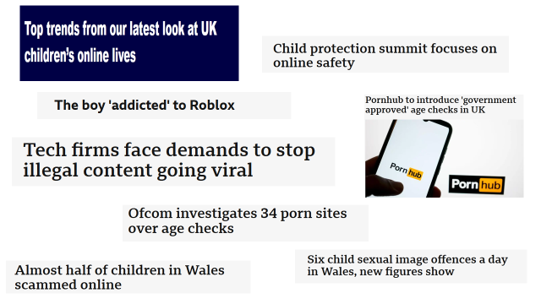
In the News

Slide 38
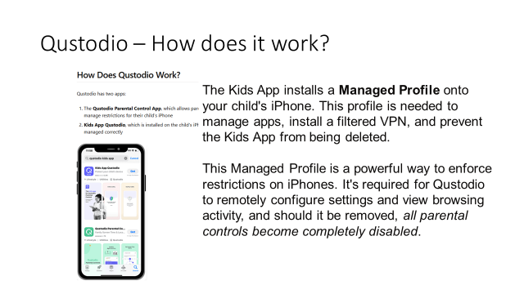

Slide 39
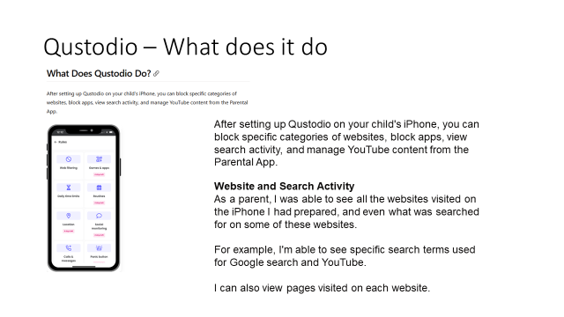

Slide 40
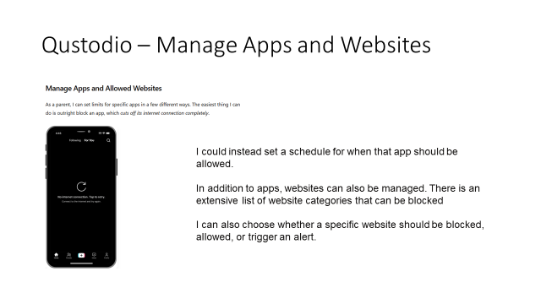

Slide 41
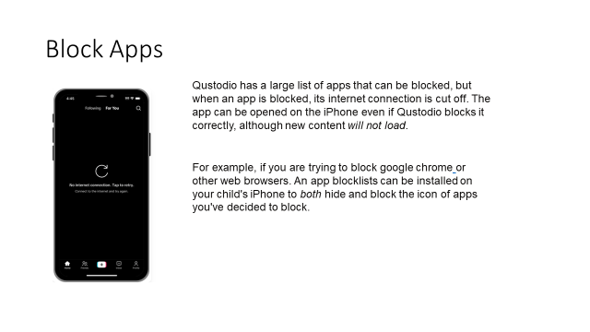

Slide 42
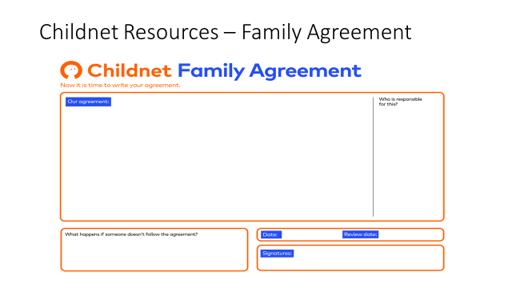

Slide 43
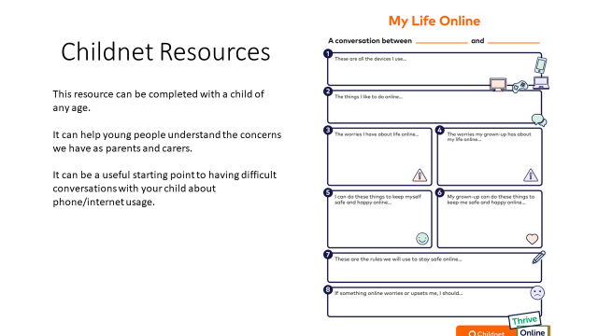

Slide 44
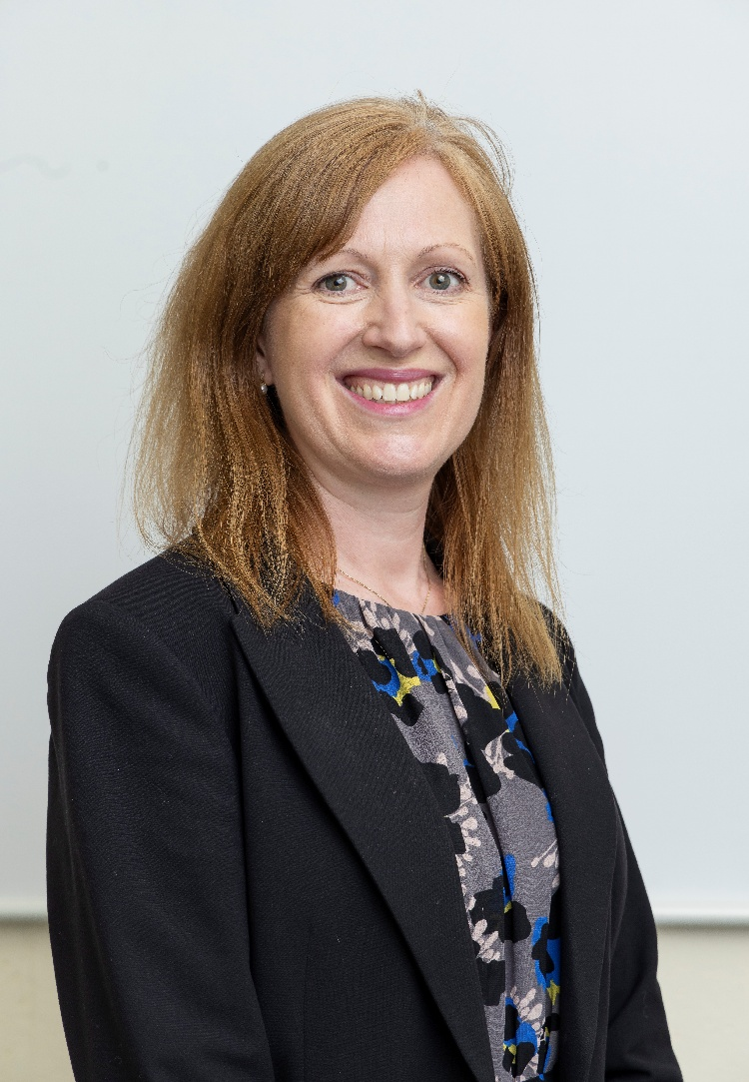
Vaccinations and Access Arrangements
Ms Fowler, Assistant Headteacher, Raising Standards: SEND

Slide 45
Year 8 – HPV Human Papilloma Virus
ALL students aged 12 to 13 are offered HPV vaccination as part of the NHS childhood vaccination programme
It consists of one injection into the upper arm -
DATE - 8th June 2026
http://www.nhs.uk

Slide 46
Year 9 – Td/IPV Vaccine (3-in-1 teenage booster)
ALL students aged 13-14 are offered the 3-in-1 booster vaccination as part of the NHS childhood vaccination programme
DATE – 2nd February 2026

Slide 47
Access Arrangements
All Year 9 students will be tested for Access Arrangements after May half term.
The criteria for the Joint Council of Qualifications (JCQ) has become stricter
25% extra time
Reader pen
Rest breaks
Use of laptop

Slide 48
Key Dates KS3
Year Group
Date
Event
KS3
3rd December 2025
KS3 Awards Evening
YEAR 8
5th February 2026
Yr 8 Parent/Carer Evening
YEAR 9
15th January 2026
Options Evening
YEAR 9
22nd January 2026
Yr 9 Parent/Carer Evening
KS3
W/c 1st June 2026
End of Year Exams

