Slide 1

YEAR 10 & 11 PARENT INFORMATION EVENING Wednesday 17th September 2025

Slide 2
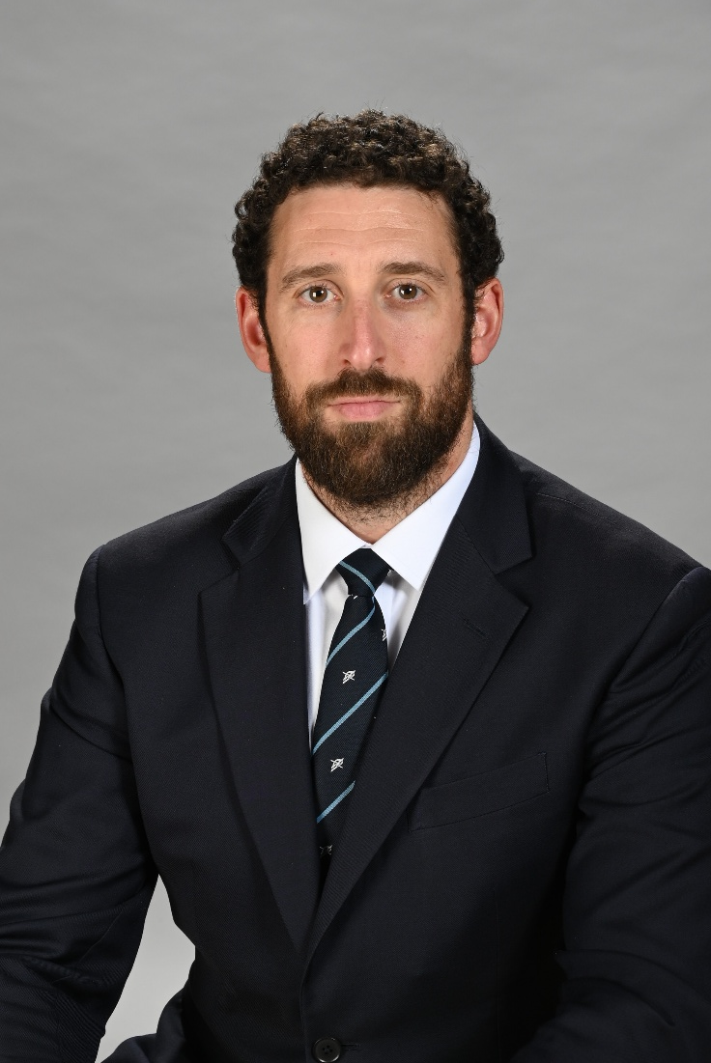
Attendance, Progress and Standards
Mr Mc Inerney, Deputy Headteacher, Raising Standards: Behaviour

Slide 3
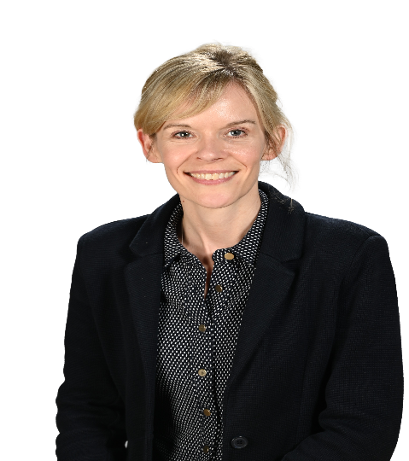
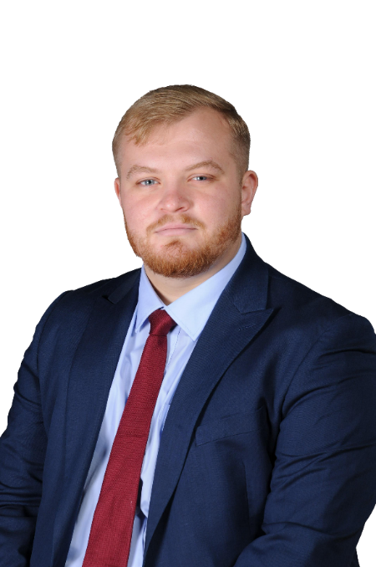
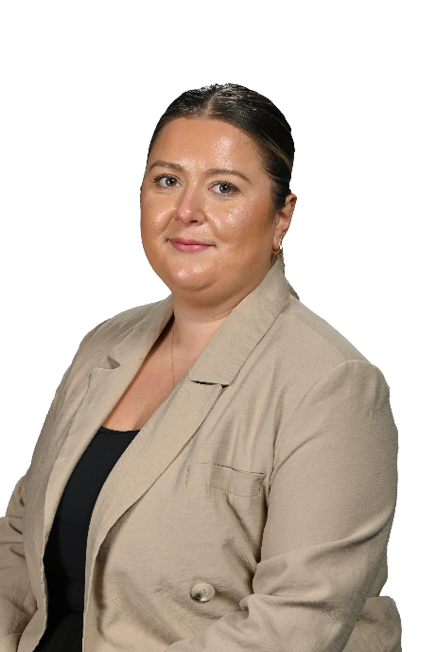
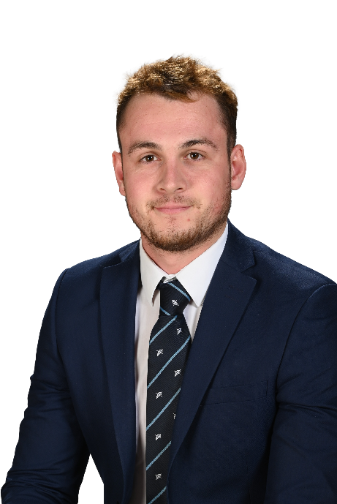
Key Year 10 & 11 Staff
Ms Clark
Head of Year 10
Mr Arnot
Head of Year 11
Ms Thumwood
Deputy Head of Year 10
Mr Forrester
Deputy Head of Year 11

Slide 4
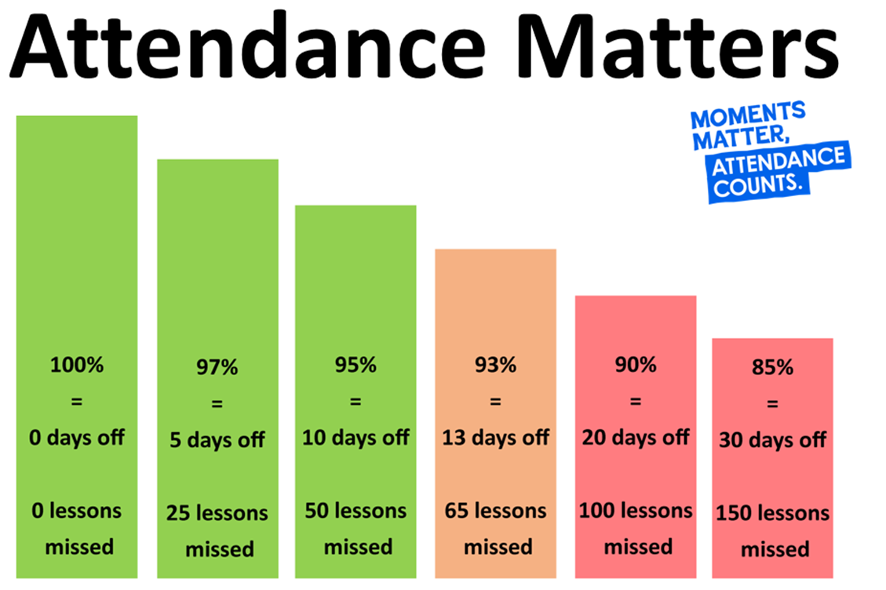

Slide 5
How Attendance Affects Results…
Year 11 exams –
Over 90% Attendance
English and Maths
4+ - 76%
5+ - 62%
Year 11 exams –
Below 90% Attendance
English and Maths
4+ - 52%
5+ - 32%

Slide 6
How Attendance Affects Progress…
Primary
Secondary
Positive progress 8
Expected progress 8
Negative progress 8
Year 1 Year 2 Year 3 Year 4 Year 5 Year 6 Year 7 Year 8 Year 9 Year 10 Year 11
Progress 8 –
Over 90% Attendance
+1.28
Progress 8 –
Under 90% Attendance
-0.13

Slide 7



Slide 8

School community Values
Social media
Mobile Phones
School Uniform

Slide 9
School Community Values
Lining up outside the gate
Changeover (Playground – no congregating)
No physical contact at break
Toilets
Lime bikes
Energy drinks
Supporting our reputation in the community

Slide 10
School Contacts
Pastoral
Form tutor
Academic
Class teacher
Deputy Head of Year
Head of Department
Head of Year
Mr Hogarth
Deputy Headteacher
Assistant Headteacher
Mr King /Mr Mc Inerney
Deputy Headteacher

Slide 12
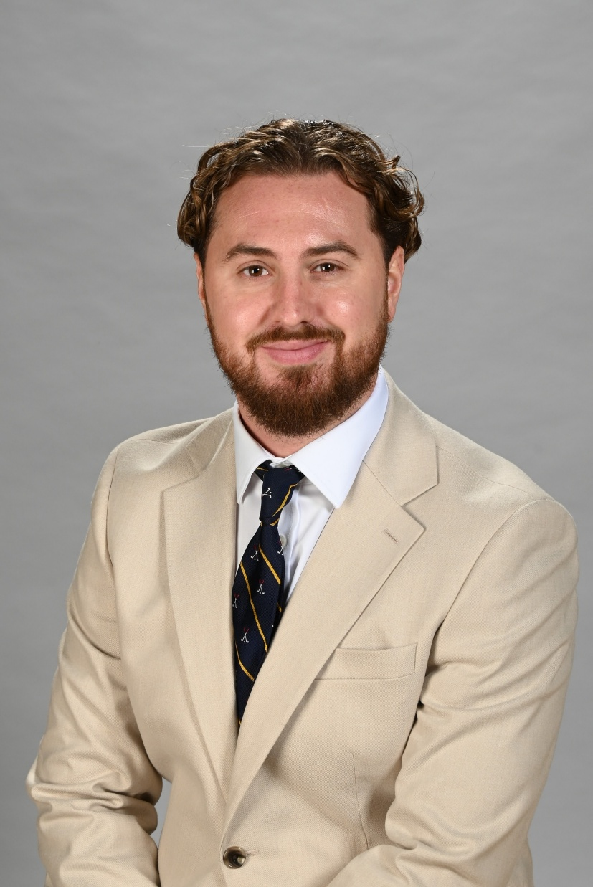
Curriculum and Homework
Mr Jones, Senior Teacher, Raising Standards and Behaviour Support

Slide 13
The RPHS Curriculum
We are very proud of our broad and balanced curriculum here at Raynes Park
It is supported by an extensive extra curricular programme
Our Heads of Department continue to examine their curriculum areas to identify what the essential knowledge and skills to be taught are
Students are given regular low stakes assessments alongside more formal tests and exams to identify gaps and inform planning
Intervention and support is targeted at students where they need it most

Slide 14
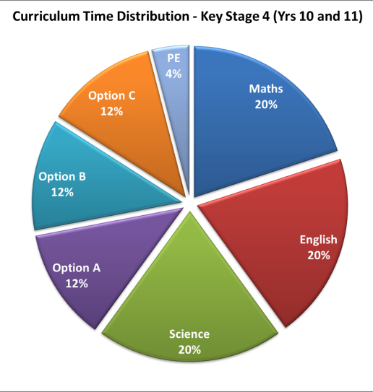
KS4 (Years 10 & 11) Curriculum
Subject | Periods | Minutes
Maths | 4 | 240
English | 4 | 240
Science | 4 | 240
Core PE | 1 | 60
Option A | 3 | 180
Option B | 3 | 180
Option C | 3 | 180
Option D | 3 | 180
Totals | 25 | 1500

Slide 15
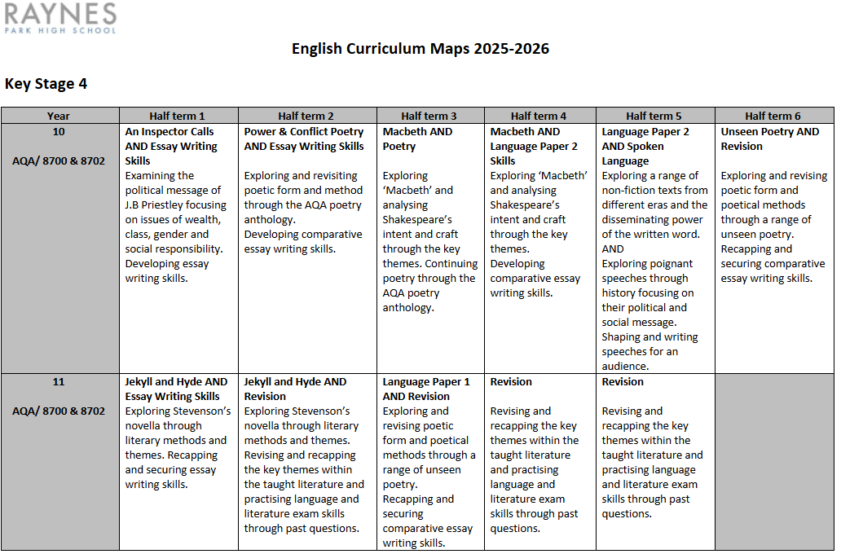
Curriculum Information Booklets

Slide 16
Aiming for 5 and above
Important to note that a grade 5 is the minimum we need to aim for
Students have found themselves in an ‘academic no-man’s land’
Have secured a 4, so no need to retake English and Maths, but not enough of an outcome to secure a Level 3 course
Just because you pass a GCSE will not entitle you to study it at 6th Form
Start to plan for post-16 now
Entry requirements are readily available so familiarise yourselves and set goals accordingly

Slide 17
Course Requirements RPHS 6th Form
Level 3 Course | Entry Requirements
Geography (A Level) | Level 6 or above in Geography or equivalent in Maths and English
Psychology (A Level) | 2 Level 6’s in Combined Science/Level 6 or equivalent in Maths and English
Sociology (A Level) | Level 6 or above in Sociology or equivalent in Maths and English
Criminology (WJEC) | 5 Level 4-9 including Level 5 or equivalent in English and 4 or equivalent in Maths
Biology ( A Level) | Level 6 or above in Biology GCSE or 2 Level 6’s in Combined Science and Level 6 or equivalent in Maths and English
Business Studies (Cambridge Technicals) | Merit or above in Level 2 Business or Level 4 or equivalent in Maths and English GCSE
English Literature (A Level) | Level 6 or above in English Literature and/or Language
Mathematics (A Level) | Level 7 or above in Mathematics
History (A Level) | Level 6 or above in History or equivalent in Maths and English

Slide 18
Assessment and Reporting
Regular Report Cards – x3 (one per term)
Academic Progress and Attitude to Learning – L.E.A.R.N.
Attitude to Learning is Assessed for both School Work and Homework
House Points
Attendance
Punctuality
Subject / Parents Evenings
Academic Target Setting and Review days

Slide 19
L | Exceptional | Learner is highly self-motivated Excellent co-operation and awareness of others Respectful of others and voluntarily assists them when it is required Work is completed to a standard far exceeding expected ability Always on time Meets all deadlines
E | Exceeding | Expected effort always exceeded Always co-operative with staff Always respectful Work is complete to a standard exceeding expected ability Always on time Meets all deadlines
A | As Expected | Allows teaching to take place uninterrupted Makes expected effort Co-operates quickly Respectful of others Completes work to a standard in line with expected ability Completes work on time
R | Below Expectations | Due to one or more of the following; Occasional low level disruption Effort can be inconsistent Variable engagement in learning activities Slow to co-operate Can be late to lessons Working at a standard below ability Sometimes fails to meet deadlines
N | Needs to Improve | Frequent disruption to lessons Minimum effort made Disengaged from learning Lacks co-operation and / or Often disrespectful Frequently late to lessons Working at a standard far below expected ability Fails to meet deadlines
Attitude to L.E.A.R.N. ing

Slide 20
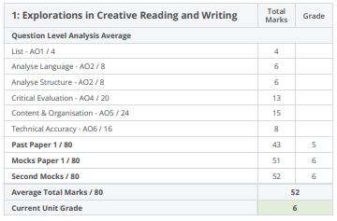
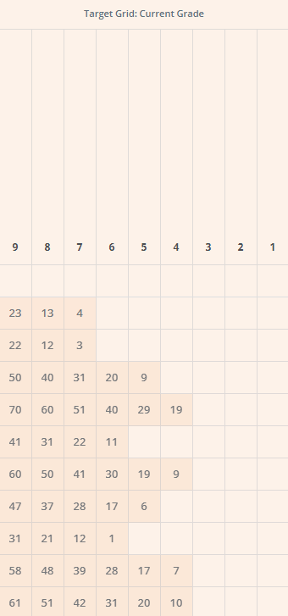
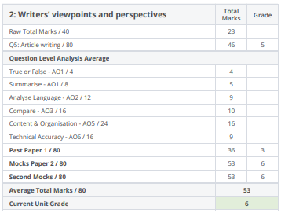
Pupil Progress
Students will get a copy of their own subject specific report
Question level/AO analysis
Clearly shows gaps in learning, proximity to grade boundaries and areas to consolidate
Teachers to use these reports to tailor intervention and strategies to support students
Talk through these reports as a family so you know exactly how your child is performing

Slide 21

Homework – Satchel One
All homework is communicated via Satchel
This can be tracked using the App or via the website
Some subjects use other online platforms too:
English – Educake
Science – Educake
Maths – Sparxx Maths
Just as important as classwork to consolidate learning, practice skills and to apply knowledge

Slide 22


RPHS Super Curriculum
Designed to inspire curiosity and deepen students’ understanding of their subjects
Foster a love of learning outside of the classroom
Wide range of self-directed tasks which link to and expand on our regular curriculum
Activities encourage students to think critically, creatively and independently
Broaden students’ understanding of the cultural and academic context of their subjects

Slide 23
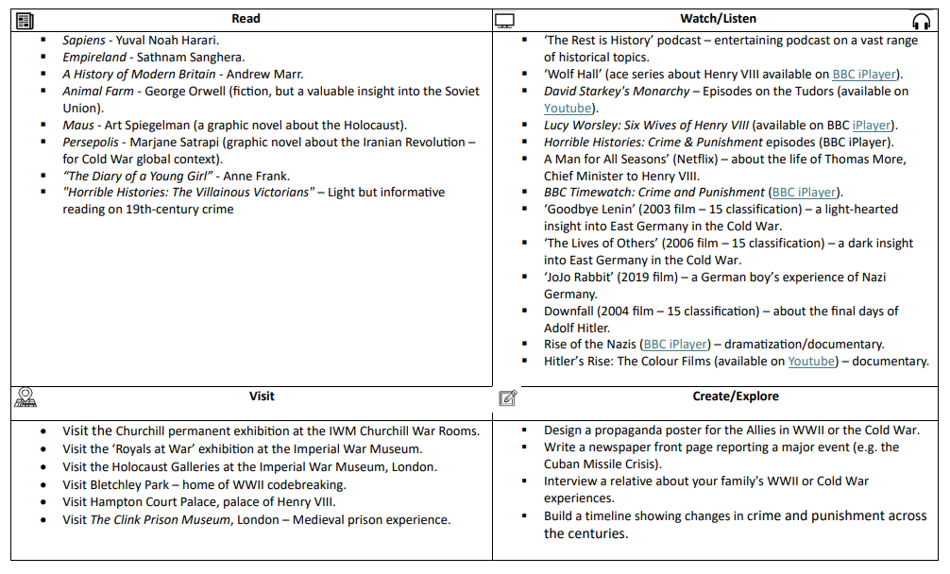

Slide 24


RPHS Super Curriculum Key Information
Access via our school website
Useful information via additional web links as outlined below

Slide 25
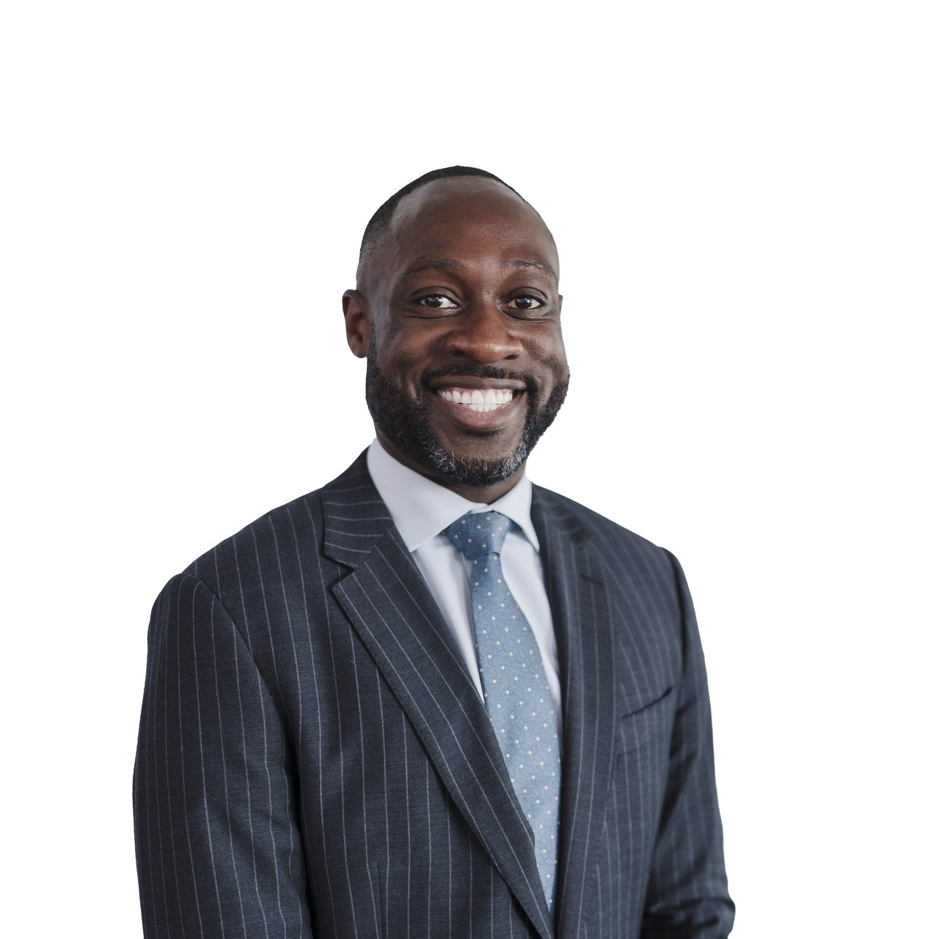
RSHE+C and Careers
Mr McCurdy, Assistant Headteacher, Raising Standards: Post 16

Slide 26






Why RSHE+C Matters in Schools
Develop life skills and knowledge
Safety
A safe space to talk
School culture and behaviour

Slide 27

Statutory Requirements in
Secondary Education
From 2020, Relationships and sex Education became compulsory in all secondary schools
A new focus in the requirements was on supporting young people to have healthy and consensual relationships (previously, only sex education was compulsory and was covered mainly in Science)
New research shows just how widespread exposure to misogyny or harmful online content has become

Slide 28
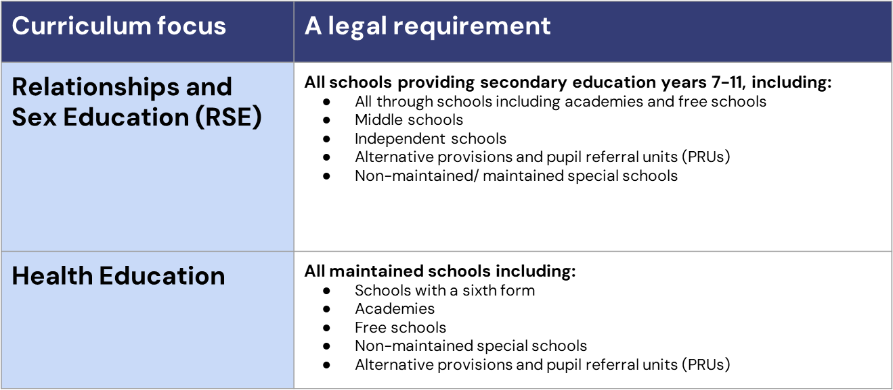
Statutory Requirements in
Secondary Education

Slide 29
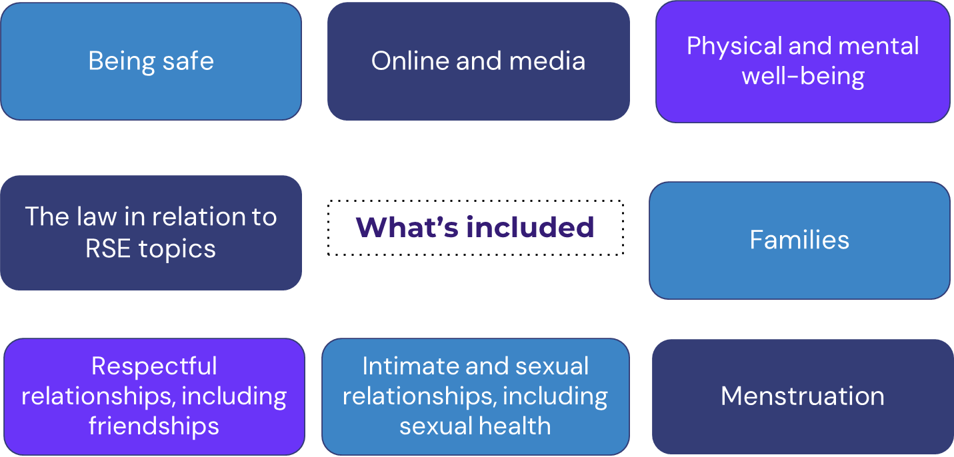
Areas of Focus

Slide 30

RPHS Resources

Slide 31
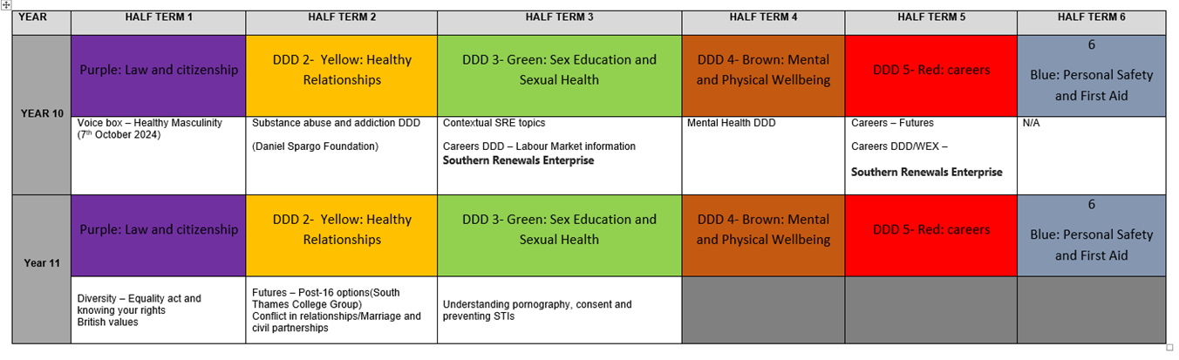

Slide 32
Age Appropriateness
We are sensitive in our approach in teaching topics at a time that will most benefit the safety and development your child.
The influence of other people including friends and older siblings
Access to technology and the world of adult focussed content it opens up
Spiralled curriculum
SEND
Neurodivergence

Slide 33
How to Support your Child in their
RSE Journey
*Our Recommendations*
Celebrate individual differences to promote a greater sense of belonging for everyone in society
Talk openly with your child to model confidence in discussing tricky topics
Listen to your child without judgement
Engage with the school’s parent consultations about RSE topics
Stay up to date with what is being taught and when so you can follow up on these topics at home
Ask for support if you need it - you are not expected to know everything!

Slide 34
New Updates
Why?
Children are increasingly exposed to harmful content online, including misogynistic attitudes and unhealthy views about relationships.
What?
In secondary school, all students learn about consent, and lessons focus on helping teenagers understand consent as well as kindness and respect as they’re getting ready for more intimate relationships.
Students will learn to identify positive role models and understand how to challenge harmful attitudes they might encounter online.
How?
Teachers will receive proper training to handle these sensitive topics effectively.

Slide 35
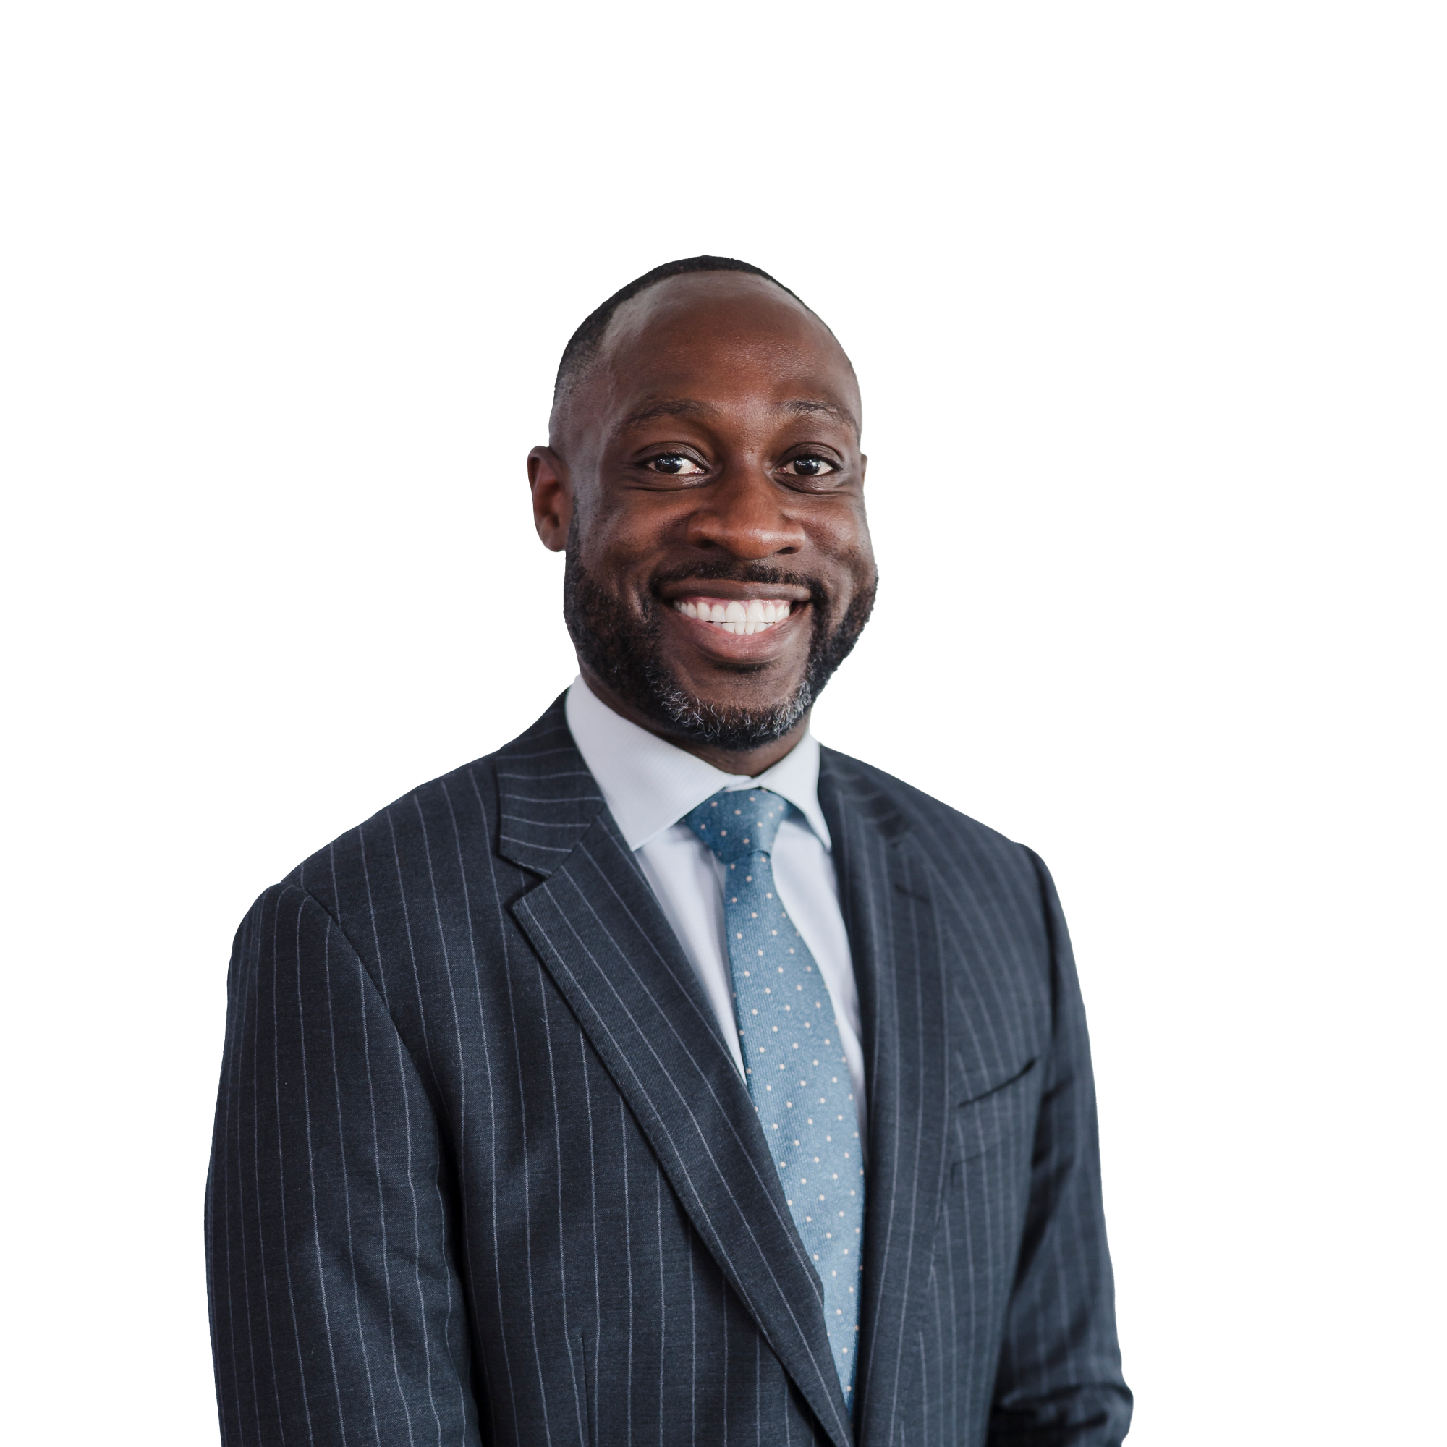

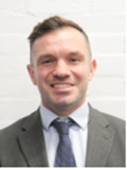
Ongoing Support
Miss Yusuf
Wellbeing Manager
Mr Nash
Assistant Headteacher:
Safeguarding & DSL
Mr McCurdy
Assistant Headteacher: PD
Click here (https://www.rphs.org.uk/attachments/download.asp?file=333&type=pdf) to view our RSHE policy
If you have any questions about the topics your child is learning, please contact the members of staff below

Slide 36
Safeguarding and Online Safety
Mr Nash (DSL), Assistant Headteacher, Raising Standards: Keeping Children Safe in Education

Slide 37
A Culture of Safeguarding
A dedicated safeguarding team
Ongoing whole staff safeguarding training
A focus on student wellbeing
A dedicated inclusion team
Great relationships with parents and carers

Slide 38


Slide 39

In the News

Slide 40
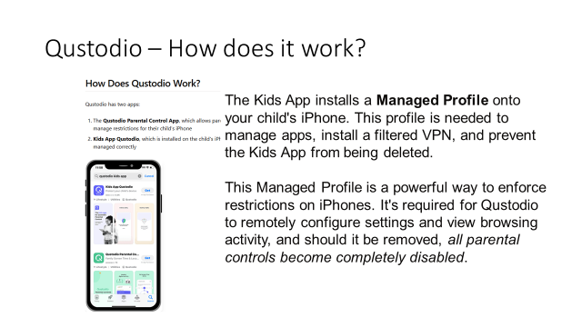

Slide 41
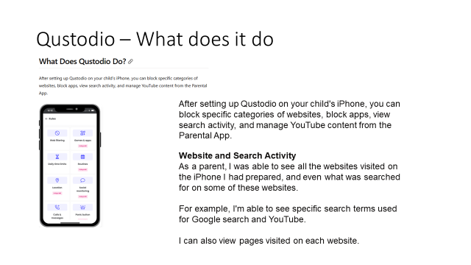

Slide 42
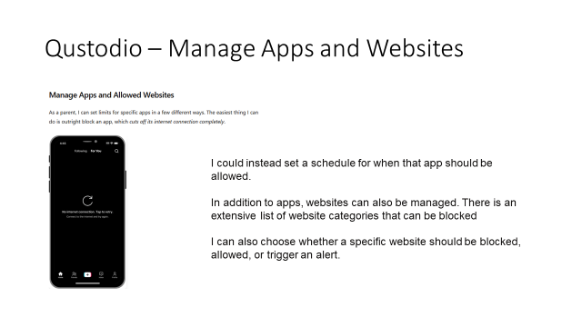

Slide 43
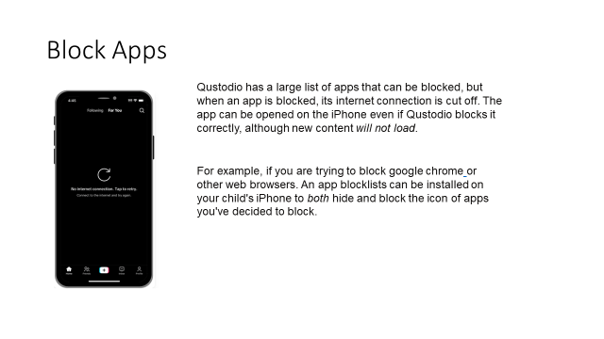

Slide 44
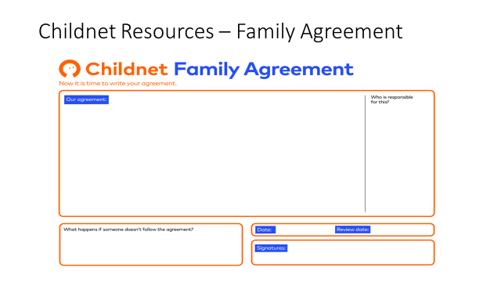

Slide 45
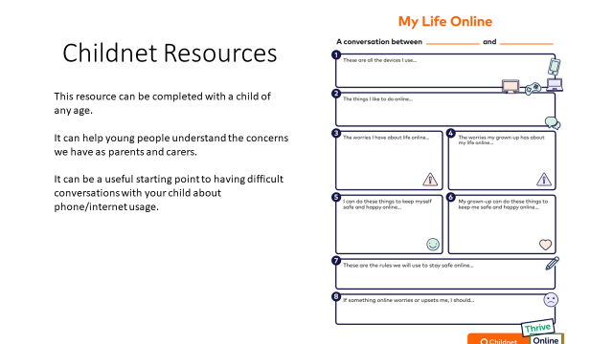

Slide 46
Key Dates
Year Group | Date | Event
KS4 | Friday 26th September | Academic Target Setting Day
KS4 | Tuesday 2nd December 2025 | KS4 Awards Evening
Year 11 | Thursday 8th January 2026 | Year 11 Parents’ Evening
Year 10 | Thursday 26th March 2026 | Year 10 Parents' Evening
Year 11 | w/b 23RD February 2026 | Mock Exams

