Slide 1



Thursday 18th September 2025
Year 7 Parent Information Evening
Notes:
A very warm welcome to RPHS
Introduce yourself as their child's form tutor
Talk about the school values:
Really focus on how we support our students to be safe and happy here at RPHS
Attendance and behaviour standards support this so that all students can learn and achieve well
We have many avenues in school to support students when they need it – as form tutor you will be the first point of contact. Encourage that open dialogue with the families.
This year we aim to:
To strengthen our ethos of Respect, Resilience and Results
To enable all our students to be happy, safe and successful
To ensure that all students attend at 95% at better and arrive on time
For students to be caring and supportive of each other
To develop and maintain a strong home-school partnership
To support students’ mental health and well being
To increase engagement in House events
To encourage all students to engage in extra-curricular and enrichment opportunities
All rooted in our systems for success – next slide

Slide 2
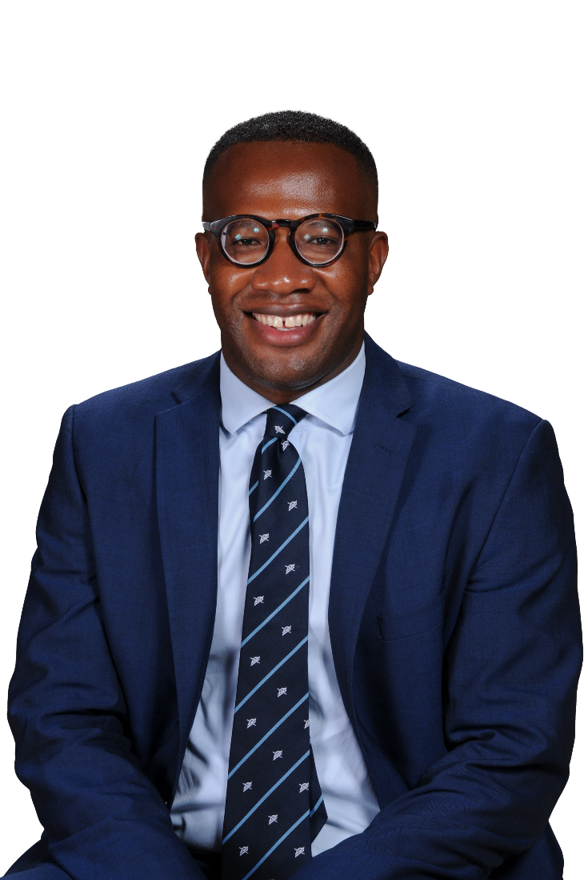
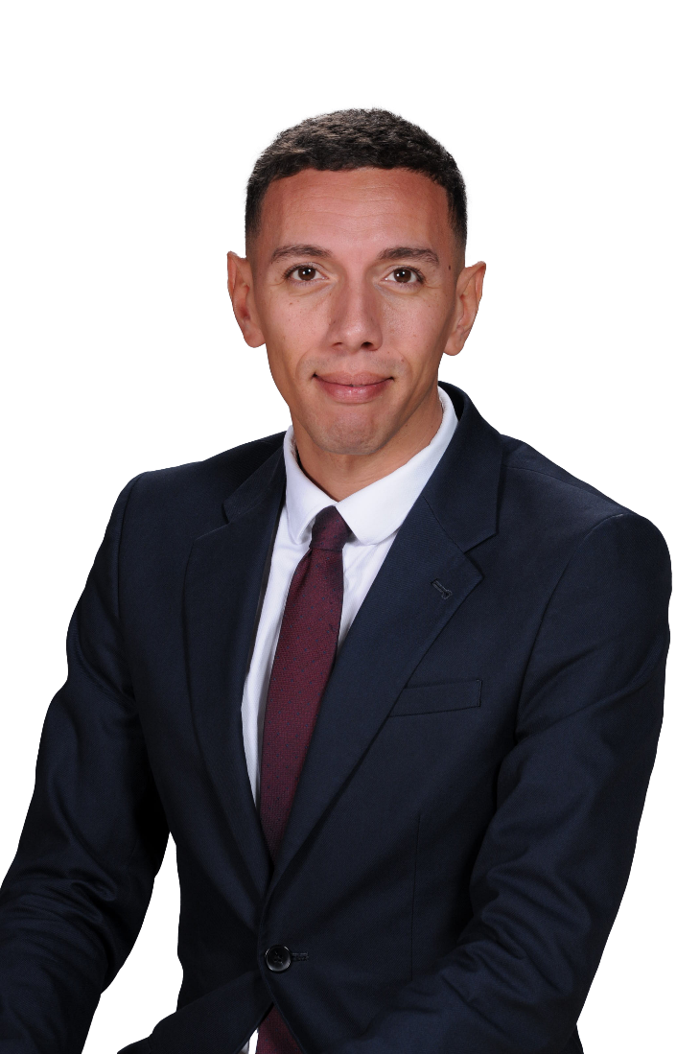
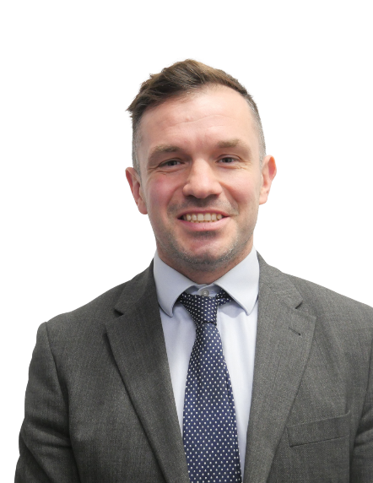
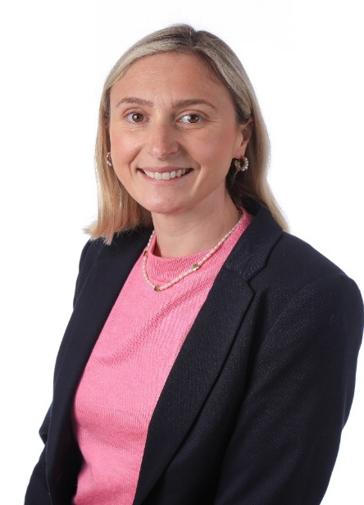
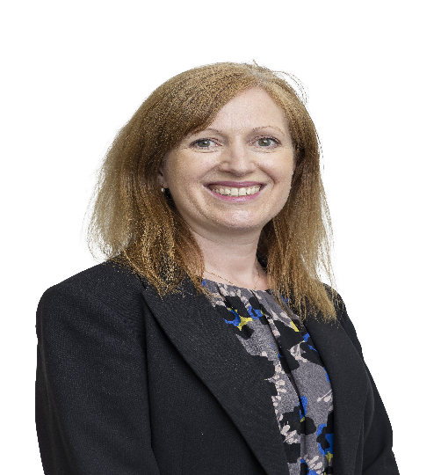
Key Year 7 Staff
Mr Burnett
Head of Year 7
Mr Bolili
Deputy Head of Year 7
Mr Nash
Assistant Headteacher (Designated Safeguarding Lead)
Mrs Macfarlane
Assistant Headteacher (Transition)
Ms Fowler Assistant Headteacher (SENCO)

Slide 3
School Contacts
Pastoral
Form tutor
Academic
Class teacher
Deputy Head of Year
Head of Department
Head of Year
Mr Hogarth
Deputy Headteacher
Assistant Headteacher
Mr King /Mr Mc Inerney
Deputy Headteacher

Slide 4
In School
Systems for Success
Year group tutor bases/break areas
Tutor Time Reading Programme
PE kit on PE and dance days
Extra-curricular clubs and activities
Enrichment
In the community
Continue to improve our reputation in the community
Local shops/Tesco
Lime bikes/Energy Drinks
Notes:
TTRP – improve reading age, develop love of reading, improve literacy – stress the importance of this to enhancing pupils' success

Slide 5
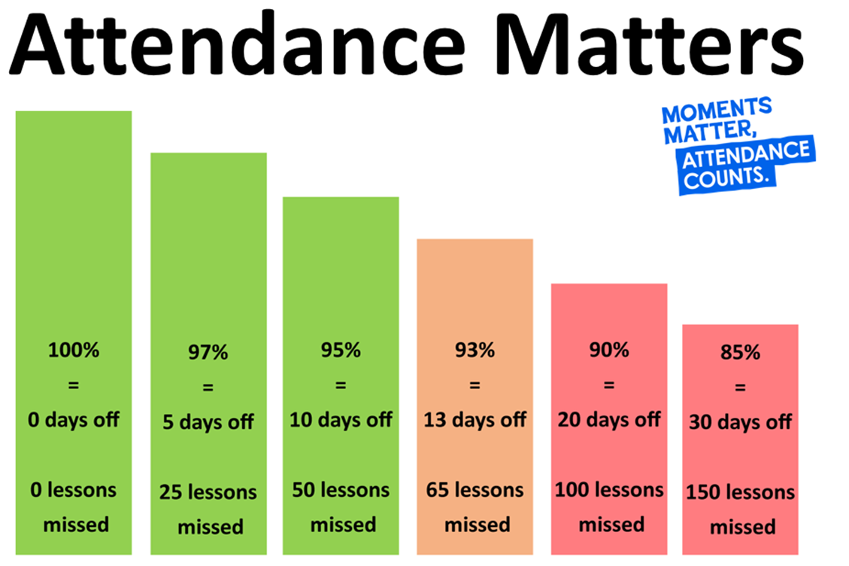
Notes:
Balance here that we understand attendance may be more challenging for some students, however, it is much easier to support students when they are IN school. Always encourage parents to call us to support them in getting their child into school.

Slide 6
How Attendance Affects Results…
Year 11 exams –
Over 90% Attendance
English and Maths
4+ - 76%
5+ - 62%
Year 11 exams –
Below 90% Attendance
English and Maths
4+ - 52%
5+ - 32%

Slide 7
A Culture of Safeguarding
A focus on student wellbeing
A dedicated Inclusion Team
Recognition of the importance of working closely with families
Any concerns can be raised anonymously using the safe@raynespark.merton.sch.uk email address

Slide 8

Online Safety
Mr Nash will share a video on the website with details of the Qustodio app
Designed to support parents in keeping their children safe online

Slide 9
KS3 (Yrs 7-9) Curriculum
Subject | Periods | Minutes
Maths | 4 | 240
English | 4 | 240
Science | 4 | 240
PE | 2 | 120
DT | 1 | 60
Geography | 2 | 120
History | 2 | 120
MFL (French/Spanish) | 2 | 120
Computer Science / ICT | 1 | 60
Art | 1 | 60
Dance / Drama / Music (Rotation) | 1 | 60
Religious Education | 1 | 60
Totals | 25 | 1500
Notes:
Key points – we offer a broad and balanced curriuclum including discreet RE lessons and a recognition of the importance of Arts/DT. We also have 2 language options and students can study 2 languages from Year 9.

Slide 10
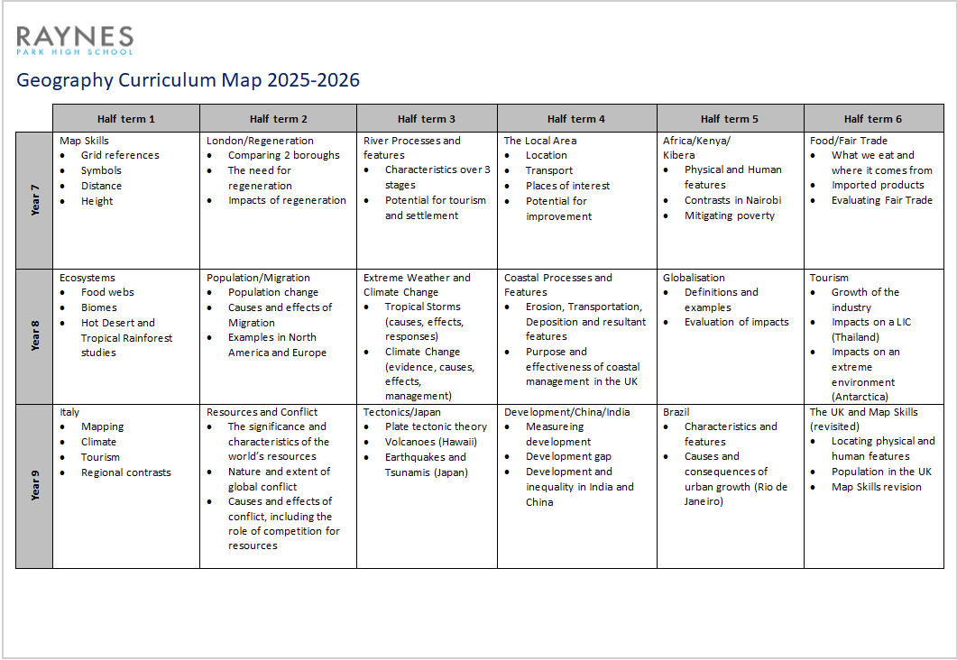
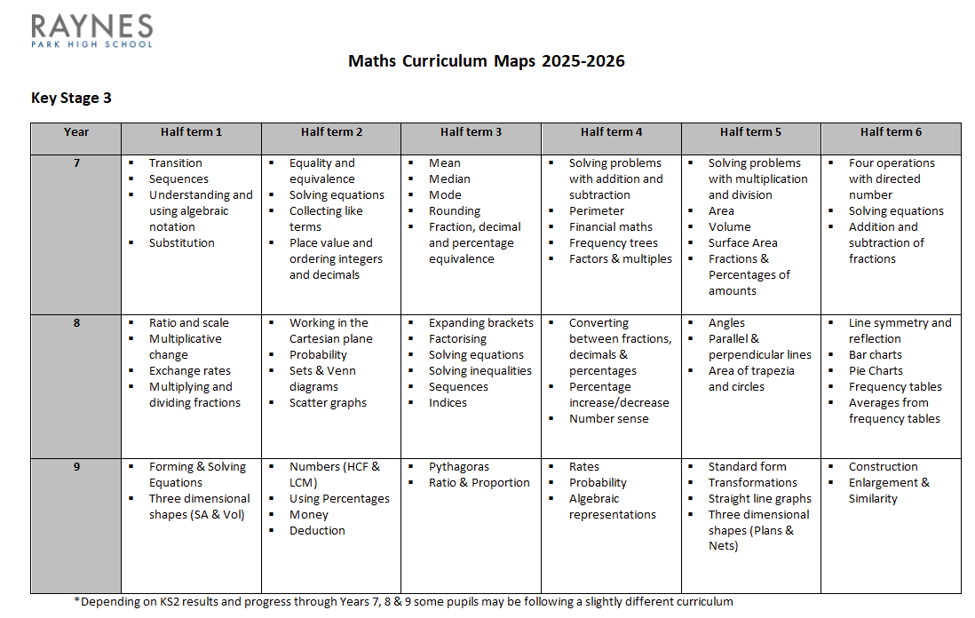
Curriculum Information Booklets

Slide 11
Assessment and Reporting
Regular Report Cards – x3 (one per term)
Academic Progress and Attitude to Learning – L.E.A.R.N.
Attitude to Learning is Assessed for both School Work and Homework
House Points
Attendance
Punctuality
Subject / Parents Evenings
Academic Target Setting and Review days

Slide 12
L | Exceptional | Learner is highly self-motivated Excellent co-operation and awareness of others Respectful of others and voluntarily assists them when it is required Work is completed to a standard far exceeding expected ability Always on time Meets all deadlines
E | Exceeding | Expected effort always exceeded Always co-operative with staff Always respectful Work is complete to a standard exceeding expected ability Always on time Meets all deadlines
A | As Expected | Allows teaching to take place uninterrupted Makes expected effort Co-operates quickly Respectful of others Completes work to a standard in line with expected ability Completes work on time
R | Below Expectations | Due to one or more of the following; Occasional low level disruption Effort can be inconsistent Variable engagement in learning activities Slow to co-operate Can be late to lessons Working at a standard below ability Sometimes fails to meet deadlines
N | Needs to Improve | Frequent disruption to lessons Minimum effort made Disengaged from learning Lacks co-operation and / or Often disrespectful Frequently late to lessons Working at a standard far below expected ability Fails to meet deadlines
Attitude to L.E.A.R.N. ing

Slide 13

Homework – Satchel One
All homework is communicated via Satchel
This can be tracked using the App or via the website
Some subjects use other online platforms too:
English – Educake
Science – Educake
Maths – Sparxx Maths
Just as important as classwork to consolidate learning, practice skills and to apply knowledge
Homework club BG4 – everyday during second break
Notes:
IT Support – Gillian – will be there on Thursday to support with Logins

Slide 14

Homework – Satchel One
Can be accessed via an App (available on Android and IOS)
The Satchel Website for our school is - https://raynespark.satchelone.com/school/home
This can be quickly accessed via our school homepage

Slide 15

Homework – Satchel One
Should you need any support with Satchel please visit the Remote Learning section of our website

Slide 16
Key Dates KS3
Year Group | Date | Event
KS3 | Friday 26th September | Academic Target Setting Day
Year 7 | Monday 29th September – Wednesday 1st October | Year 7 Residential
Year 7 | Thursday 11th December 2025 | Year 7 Progress Evening
Year 7 | Friday 13th February 2026 | Year 7 Valentines Disco
Year 7 | Thursday 12th March 2026 | Year 7 Parents' Evening
KS3 | w/b 1st June 2026 | End of Year exams
Whole School | Monday 13th July 2026 | Academic Review Day

Slide 17
Thank you!
Please feel free to ask me any questions you may have.
We invite you to join us for refreshments and an opportunity to view some of the transition work in the Main Hall.
Residential Parents' Evening
This will take place in the Main Canteen at 5.15pm

