Slide 1
Physical
Geography Investigation
Summer 2023
The Water Cycle

Slide 2
A Level Physical Geography
An Introduction:
What is Physical Geography A-level?
Physical Geography at A-level dives deeper into the world’s natural processes which occur on various scales, enlightening you into the more complex nature of the natural world around you. You will then investigate how these natural phenomenon come to shape the lives of humans.
Why should you study the topic?
The relevance of the topics which you study for A-level Geography to your daily lives is startling. Whether walking to school and seeing the carbon and water cycle in action, understanding the impact of our changing climate on some of our most fragile ecosystems, or understanding the role of governments in protecting people from hazards, what you learn can be applied to every day conversations.
Completing this work before you begin Year 12 will give you an outstanding start to the Edexcel A Level Geography course. You’ll be on your way to achieving great things over the next 2 years.
I hope you enjoy your journey into the world of Physical Geography!

Slide 3
The Water Cycle Topics Tracker
Topic focus | Page number | Completed [tick when complete]
Key words | 4
The water cycle in action video task | 7
Large and Local scale water cycle | 9
How The Water Cycle Works | 11
Positive and Negative Feedback | 14
Need Help?
Whilst the intention of this work is to encourage independent thought and research, please ask for advice if you feel it will help.
Email me from your school email account:
gcollman@raynespark.merton.sch.uk

Slide 4
Key words
Key words form the basis of physical geography. Without them, you are not speaking the language of geography. No matter how well you understand a process or concept, you cannot explain it clearly without using key words.
Task: Using the table on the following page, match up the key words with the definitions. To save you drawing lines and it looking messy, each key word has been given a number which you can write next to the correct definition. The first one has been done for you.
Once you have completed this, check your answers on the next page.

Slide 5
Key word | Definition
1. Water cycle | The way water is stored and moves on different scales 1
2 Open system | Places where water can be held in the water cycle
3 Closed system | The loss of water from a plant cell due to heat
4. Precipitation | The cooling of water vapour to form liquid water (in cloud form)
5. Interception | The movement of water over the ground surface, straight into the river channel. This is the fastest flow of water into a river channel
6 Infiltration | When matter (such as water) can enter or exit an area (the system), meaning the mass of water held in the area can increase of decrease
7. Percolation | The downwards movement of water from the soil layer into the rock layer below it
8. Throughflow | When soil has absorbed as much water as possible and cannot allow any more to infiltrate
9. Groundwater flow | Water which has percolated into rock will move horizontally through the rock layer towards the river channel (usually down a slope due to gravity)
10.Surface runoff | When vegetation (plants) store and hold onto water which has been precipitated
11. Soil saturation | Water which has infiltrated into soil will move horizontally through the soil layer towards the river channel (usually down a slope due to gravity
12. Evaporation | Water falling from the sky as rain, snow, sleet or hail
13. Condensation | The heating of liquid water on the ground surface, creating water vapour
14. Transpiration | The movement of water from one store to another
14. Store | The downwards movement of water from the ground surface into the top soil layer through absorption
15. Transfer | When matter (such as water) cannot enter or exit an area, so the mass of water never changes

Slide 6
Key words – correct definitions
Key word | Definition
1. Water cycle | The way water is stored and moves on different scales
2 Open system | When matter (such as water) can enter or exit an area (the system), meaning the mass of water held in the area can increase of decrease
3 Closed system | When matter (such as water) cannot enter or exit an area, so the mass of water never changes
4. Precipitation | Water falling from the sky as rain, snow, sleet or hail
5. Interception | When vegetation (plants) store and hold onto water which has been precipitated
6 Infiltration | The downwards movement of water from the ground surface into the top soil layer through absorption
7. Percolation | The downwards movement of water from the soil layer into the rock layer below it
8. Throughflow | Water which has infiltrated into soil will move horizontally through the soil layer towards the river channel (usually down a slope due to gravity)
9. Groundwater flow | Water which has percolated into rock will move horizontally through the rock layer towards the river channel (usually down a slope due to gravity)
10.Surface runoff | The movement of water over the ground surface, straight into the river channel. This is the fastest flow of water into a river channel
11. Soil saturation | When soil has absorbed as much water as possible and cannot allow any more to infiltrate
12. Evaporation | The heating of liquid water on the ground surface, creating water vapour
13. Condensation | The cooling of water vapour to form liquid water (in cloud form)
14. Transpiration | The loss of water from a plant cell due to heat
14. Store | Places where water can be held in the water cycle
15. Transfer | The movement of water from one store to another

Slide 7
The Water Cycle in Action
https://www.youtube.com/watch?v=al-do-HGuIk
Watch the video and complete the questions below.
Has the amount of water on Earth changed over millions of years?
2. List 3 ways water moves (is transferred) across the world (between stores)
3. In order to form clouds, water has to…
4. Where is 70% of all the water on Earth stored?
Think, why is this water not useful to humans?
5. Where is two thirds of all freshwater stored?
6. Where else can freshwater be stored? Aim for 6 different stores.
7. Why are the stores of water always changing?
8. What is precipitation? Give as many examples as possible (you should already know from the task before)

Slide 8
The Water Cycle in Action
https://www.youtube.com/watch?v=al-do-HGuIk
9. What is rain which falls onto land called and why might this cause flooding?
10. What is meant by interception?
11. Name the layers below the Earth surface.
12. What is evaporation? Is this a store or transfer of water?
13. What is transpiration?
14. What is evapotranspiration?
15. What is condensation and what does it lead to occurring?

Slide 9
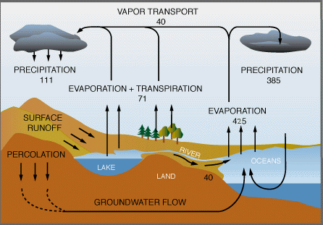
Large and Local Scale Water Cycles
Large scale water cycles are so special that only one exists on the whole planet. This is known as the “Global Water Cycle”. This is the circulating of water around Earth, a closed system where no water is ever lost or gained, but simply moved about. Your task: Put the key words in the boxes into the correct place on the diagram. Precipitation and evaporation have been used twice.
Evaporation
Transpiration
Evaporation
Precipitation
Infiltration
Water vapour movement
Precipitation
Surface runoff

Slide 10
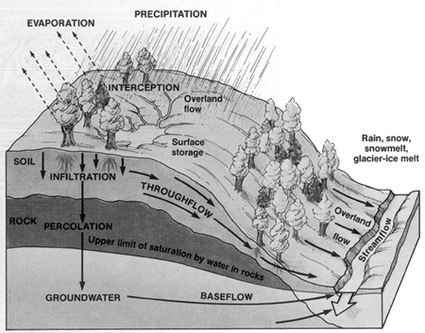
Large and Local Scale Water Cycles
Local, or smaller scale water cycles are called “subsystems”, and will usually be open systems, where water can move in and out of the system. A good example of a small scale water cycle or subsystem is a river channel on a hillslope or a drainage basin. Your task: Put the key words in the boxes into the correct place on the diagram of the hillsplope.
Overland flow/surface runoff
Groundwater
Throughflow
Evaporation
Precipitation
Percolation
SOIL
Channel flow
Rock
Interception
Groundwater flow
Infiltration

Slide 11
Reading Time: How The Water Cycle Works
Task 1: Read through the paragraph below and circle the letter which best answers the questions on the next page. The first one has been done for you.
Before we look at the water cycle and how water moves around the Earth on different scales, it is important to know what a “cycle” is. In A-level geography we use the word “system” to explain the complicated, always changing water cycle, you will see why the term is used in a minute. A system can be defined as, “a collection of parts which work together to create something which works”. In this way, the water cycle has many “parts” known as stores, and there are many specific interactions between the stores. These interactions are better known as transfers. It is worth noting here that “processes” (things which are happening) such as evaporation, condensation and precipitation, are all examples of transfers of water.
For example, a store of water is a river, and the transfers interacting with the river could be evaporation and precipitation. As water moves into the system via precipitation, the store of water (the river) gets larger. This movement of water into the river is called an, “input”, and evaporation, where water leaves the store is called an “output”. Both precipitation and evaporation show movement of water, either to or from the river. In this way, precipitation and evaporation are known as “transfers”. The greater the amount of transfers which a store receives as inputs, the greater the store of water in the river channel will grow. However, at the same time, transfers which leave the store, or outputs, will see a decrease in the size of the water store.
The amount of water stored globally (in the entire world) never changes, so the global water cycle never sees inputs and outputs. This means that no water ever leaves or enters Earth, so the mass of water on Earth stays the same. However, there as smaller scale water systems which operate within the global water cycle. An example of a small-scale water system could be a river channel which flows down a hill slope. The mass of the water stored in the river channel will change constantly. During certain time periods, evaporation may be higher (more water output) and precipitation may be lower, (less water input). This means that the mass of water in the river channel will be lower in this particular river. However, just because the water has been lost from this particular river channel, does not mean that the water has disappeared from Earth. The water which has been evaporated from this river channel, will likely turn into clouds and be stored in the sky, later on, it might enter another river channel through precipitation.

Slide 12
Question time
Circle the letter which best answers the question using the passage on the previous page. The first one has been done for you.
Which of the following is the best definition of a system?
Movement of matter such as water out of a place
A collection of parts which change as they are affected by processes
Transferring of many different materials to the same place
2. Which of the following is the best definition of a store?
Part of a system where water is gained
Part of a system where water is lost
Part of a system where water is held
3. Which of the list below outlines examples of stores of water?
Precipitation, evaporation, river channel, surface water
Surface water, cloud, evaporation, flooding
Puddle, river channel, cloud, soil
4. Circle the best definition of a transfer of water
The carrying of water in a constant cycle between two stores
The movement of water from one store to another via inputs and outputs
The output of water from a store
5. Which of the list below outlines examples of transfers of water?
Precipitation, clouds, soil, river channel
Precipitation, infiltration, surface runoff
Precipitation, evaporation, clouds

Slide 13
6. Which of the following factors will increase evaporation?
More sunlight
More rain
More clouds
7. Which of the following is the correct definition of an input?
Transfer of water from a store, decreasing the mass of water held in that store
The store of water, such as a cloud or a puddle
Transfer of water into a store, increasing the mass of water held in that store
8. Which of the following is the best definition of a closed system?
When inputs and outputs are equal
When there are many inputs and outputs to and from a system
When a system has no inputs or outputs, so the mass of matter (such as water) doesn’t change
9. Which of the following is the correct definition of an input?
Transfer of water into a store, increasing the mass of water held in that store
Transfer of water from a store, decreasing the mass of water held in that store
The store of water, such as a cloud or a puddle
10. Which of the following statements is not correct?
The Earth is an example of a closed water system, here there is never a net loss or gain of water
The Earth is an example of a closed water system, water is always being lost and gained from this system
The Earth has no inputs or outputs of water to or from it, but the smaller water systems within Earth do change in water mass due to inputs and outputs
11. Which of the following best defines the word “process”?
A store of something where matter is held
An action which can occur, leading to a transfer of matter.
A transfer

Slide 14
Positive and Negative Feedback in Systems
Systems always naturally try to maintain their own balance. This happens in all systems, no matter how big or small, from the global scale water cycle of evaporation, condensation and precipitation, to a small river with the same processes occurring,
This means that, if evaporation in increases, the ocean does not dry up, in fact, because of increased evaporation, condensation also increases, and therefore so does precipitation, causing rain to fill up the oceans again. This balancing effect is known as a negative feedback system, which reacts to a process which is happening (evaporation) by increasing processes to reverse its effects (thereby increasing condensation and precipitation). Because of this negative feedback, a system will usually stay in balance or what is known as a dynamic equilibrium. If we pick these words apart, we see that the system is in balance (equilibrium), but that this system is always changing (it is dynamic) due to inputs (such as precipitation) and outputs (such as evaporation).
Read through the following definitions of positive and negative feedback and decide if the examples in the boxes on the next page are examples of positive or negative feedback.
Positive feedback – when a process occurs in a system, creating a change, this then creates another change which amplifies (increases) the original change. When this happens, a system will be out of balance as one process is not cancelling out or balancing the other.
Negative feedback – when a process occurs in a system, creating a change, this change then causes another process to occur, which nullifies (cancels out) the original process, meaning the system is always in balance due to negative feedback.
Dynamic Equilibrium – the ever changing balance which systems achieve through negative feedback systems.

Slide 15
Positive or Negative Feedback in the Water Cycle?
Temperatures increase, increasing evaporation rates, increasing water vapour in the air, increasing condensation, increasing precipitation, causing cooling and a drop in temperature.
Sea temperatures rise due to higher atmospheric temps, ice melts, fewer heat reflective surfaces (ice) and more heat absorbent surfaces (ocean water which is dark blue). More heat absorbed by oceans, ocean temperatures rise.
Temperatures increase due to the Greenhouse Effect, this increases the rate of evaporation, increasing water vapour in the atmosphere. Water vapour is a greenhouse gas, which absorbs heat which is trying to leave the atmosphere. More heat is trapped, temperatures increase.
In a tropical rainforest, heavy precipitation potentially leads to flooding. Flooding can occur when precipitation is high due to higher temperatures, more plant growth due to high sunlight and high rainfall, meaning a lot of vegetation cover and therefore a lot of interception, therefore a lower likelihood of flooding.
Temperatures increase, increasing evaporation rates, increasing water vapour in the air, increasing condensation, increasing cloud cover, reducing the amount of heat from the sun which reaches the surface of the Earth, causing a decrease in temperature.

Slide 16
Congratulations!
You have completed your
Physical Geography Project.

Slide 18
Human
Geography Investigation
Summer 2023
Globalisation

Slide 19
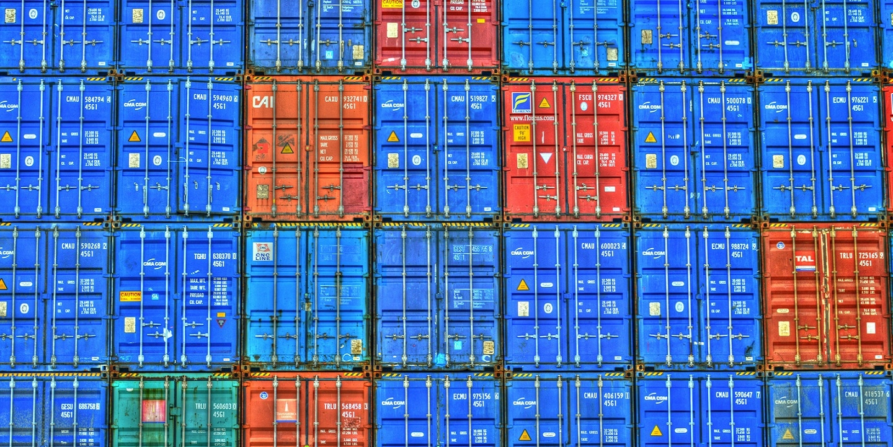
“Globalisation is undoubtedly a force for good” To what extent do you agree with this statement?
Completing this booklet will enable you to answer the question above.. This work, along with the Physical booklet, will give you the best preparation imaginable for your Edexcel A Level course. These topics are central to the specification.
You do not need to answer the question yet. Just build up your knowledge, understanding and opinions…
Globalisation is the word used to describe the growing interdependence of the world’s economies, cultures, and populations, brought about by cross-border trade in goods and services, technology, and flows of investment, people, and information. Countries have built economic partnerships to facilitate these movements over many centuries, but the term gained popularity after the Cold War in the early 1990s.
Globalisation defines your everyday lives, it is relatable, current and topical. Consider this quote from the Martin Luther King Jnr:
“Did you ever stop to think that you can’t leave for your job in the morning without being dependent upon most of the world? You get up in the morning and go to the bathroom and reach over for the sponge, and that’s handed you by a Pacific Islander. You reach for a bar of soap, and that’s given to you at the hands of a Frenchman. And then you go into the kitchen to drink your coffee for the morning and that is poured into your cup by a South American. And maybe you want tea: that’s poured into your cup by a Chinese. Or maybe you desire to have cocoa for breakfast, and that’s poured into your cup by a West African. And then you reach over for your toast, and that’s given you at the hands of an English-speaking farmer, not to mention the baker. And before you finish eating breakfast in the morning, you’ve depended on more than half the world. This is the way our universe is structured. It is its interrelated quality. We aren’t going to have peace on earth until we recognize this basic fact of the interrelated structure of all reality.”
He wrote this back in 1967, the world is far more interconnected and interdependent 55 years on!

Slide 20
“Globalisation is undoubtedly a force for good” To what extent do you agree with this statement?
Completing the tasks in this booklet will help you build answers to the following questions:
What globalisation is.
What drives globalisation.
Who globalisation affects.
How globalisation impacts you and others on the “local” level, both positively and negatively.
How globalisation creates “winners and losers”.
How globalisation can be a force for good socially, economically and environmentally.
How globalisation has been detrimental to people and places socially, economically and environmentally.
“…globalisation is a powerful force that has influenced global growth and development. Driven by the mobility of goods, services, capital, labour and technology, it has brought a large array of new opportunities and benefits. Yet globalisation also has attendant challenges and risks, manifested by imbalances in the distribution of its benefits and costs” UN Assistant Secretary-General S. Akhtar, 2013.

Slide 21
Globalisation Tasks Tracker
Task | Completed [tick]
This is Personal: Globalisation in my House
This is Personal: iPhone flow chart
Technology winners notes
Technology losers notes
Global Shift notes
Need Help?
Whilst the intention of this work is to encourage independent thought and research, please ask for advice if you feel it will help.
Email me from your school email account:
gcollman@raynespark.merton.sch.uk

Slide 22
Globalisation This is personal…
Before you begin, you must first realise how globalisation affects YOU and those around you:
Making globalisation personal 1 (your house):
Take a 5 minute stroll around your house and your mission is to find items of all shapes/sizes/kinds/uses which originate outside of the UK. Make this into a table like this - I’ve begun it with the items around me.
2) Making globalisation personal 2 (your devices):
Read this https://www.wired.com/2016/04/iphones-500000-mile-journey-pocket/ and make a flowchart which follows the iPhone’s journey right into your pocket in the UK! Mention every country which has involvement in the production.
This still applies even if you do not own an Apple device!
Item | Country of origin | Importance to me
WD hard drive | Malaysia | Stores my documents and PowerPoints
Coffee (Nespresso Colombia) | Colombia, Switzerland | Keeps me awake and helps me concentrate

Slide 23
Globalisation in my House!
Globalisation This is personal…
Item | Country/city of origin | Importance to me

Slide 24
iPhone Flow chart!
Globalisation This is personal…

Slide 25
Technology!
“WINNERS & LOSERS”
It took 1,000 years for the invention of paper to spread from China to Europe. Nowadays, in a world that has become more integrated, innovations spread faster and through many channels.
Globalisation is all about FLOWS, and the flows of ideas and technology are key:
This article covers 10 medical innovations which are saving lives across the world:
https://medicalfuturist.com/the-10-most-innovative-health-technologies-saving-millions-in-the-developing-world/
Read the article, chose 3 examples and explain how globalisation can be a force for good!
CHALLENGE: Read about how Artificial Intelligence could help humanity: https://www.forbes.com/sites/forbestechcouncil/2018/08/23/ai-for-humanity-using-ai-to-make-a-positive-impact-in-developing-countries-2/#f5d94e71b08a

Slide 26
Technology!
“WINNERS & LOSERS”

Slide 27
Technology!
“WINNERS & LOSERS”
Whilst the spread of technology undoubtedly brings with it great rewards, it is not without its disadvantages…
https://thriveglobal.com/stories/why-developing-countries-will-be-left-behind-by-automation/
https://www.weforum.org/agenda/2016/11/in-the-developing-world-two-thirds-of-jobs-could-be-lost-to-robots
https://www.bbc.co.uk/news/business-47852589
https://www.weforum.org/agenda/2018/07/robots-robots-everywhere-what-does-it-mean-for-developing-countries
https://www.bloomberg.com/opinion/articles/2018-09-17/artificial-intelligence-threatens-jobs-in-developing-world
Pick any two of the above articles and consider the following questions as you make notes on the next page:
Why does the spread of technology threaten developing countries?
What solutions can be used to combat this?
Why is the manufacturing industry so important to developing countries?
On balance, do new technologies present more advantages or more disadvantages to developing countries?

Slide 28
Notes Area (Losers from Flows of Technology)
Brief notes on what I found interesting: | How this is evidence that globalisation is/is not a force for good:
3 key FFDN (facts/figures/dates/names): 1. 2. 3. | Keywords & their definitions:

Slide 29
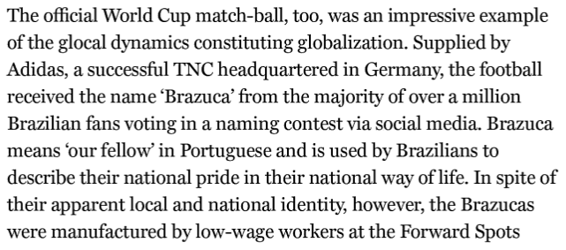
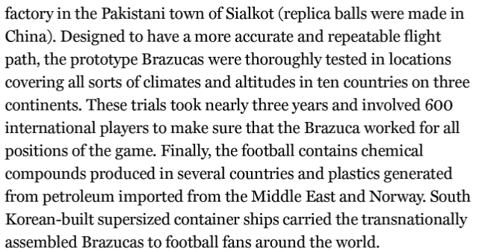
AN ASIDE…
What is fascinating about globalisation is how it is part and parcel of OUR everyday lives. Take this, an extract from “A Very Short Introduction to Globalisation” on the football used in the 2016 FIFA World Cup in Brazil:
HOW DOES THIS PROVE HOW GLOBALISATION IS SO RELEVANT TO YOU AND YOUR FAMILIES? (..even if you don’t watch football!)

Slide 30
ANOTHER ASIDE…
As a momentary distraction – take a look at this anecdote which people use to illustrate globalisation – it concerns the death of Princess Diana, Dodi Fayed and their driver in 1997:
“An English princess with an Egyptian boyfriend crashes in a French tunnel, riding in a German car with a Dutch engine, driven by a Belgian who was (allegedly) drunk on Scottish whisky, followed closely by Italian paparazzi riding Japanese motorcycles. Then treated by an American doctor, using Brazilian medicines. This is sent to you by an Englishman, using Bill Gates' (American) technology, and you're probably reading this on your computer that uses Taiwanese chips and a Korean monitor, assembled by Bangladeshi workers in a Singapore plant, transported by Eastern European lorry-drivers…”
WHY IS THIS A GOOD ILLUSTRATION OF WHAT GLOBALISATION IS?

Slide 31
Global Shift!
The ‘global shift’ is a consequence of globalisation and the increase of foreign direct investment by TNCs in newly industrialising countries. (NEEs include the Asian Tigers – South Korea, Taiwan, Singapore and Hong Kong, which started industrialising in the 1960s as well as China and India).
Global shift means an increase in proportion of global manufacturing carried out in NEEs in the last 30 years. The majority of this is happening in Asia. Global shift has led to deindustrialisation in key industrial areas in the UK (South Wales, for example) and combined with outsourcing (when a company hires another individual to perform tasks) has led to huge job losses in developed countries.
Use four of the following links and your own research to look into the global shift and outsourcing and its negative economic impacts worldwide:
https://www.thebalance.com/how-outsourcing-jobs-affects-the-u-s-economy-3306279
https://www.irishtimes.com/culture/books/the-dark-side-of-globalisation-1.3516550
https://www.bbc.co.uk/news/business-38600270
https://ftalphaville.ft.com/2016/12/06/2180771/how-many-us-manufacturing-jobs-were-lost-to-globalisation/
https://www.epi.org/publication/china-trade-outsourcing-and-jobs/
https://www.theguardian.com/world/2009/nov/01/detroit-michigan-economy-recession-unemployment
https://www.governing.com/commentary/gov-legacy-city-struggling-cities.html
https://www.ft.com/content/b2751878-c10d-11e5-846f-79b0e3d20eaf
https://www.theguardian.com/business/2019/may/29/redcar-how-the-end-of-steel-left-a-tragic-legacy-in-a-proud-town
https://www.economicshelp.org/blog/27657/unemployment/structural-unemployment/

Slide 32
Notes area (Global Shift)
Brief notes on what I found interesting: | How this is evidence that globalisation is/is not a force for good:
3 key FFDN (facts/figures/dates/names): 1. 2. 3. | Keywords & their definitions:

Slide 33
Congratulations!
You have completed your
Human Geography Project.

