Slide 1
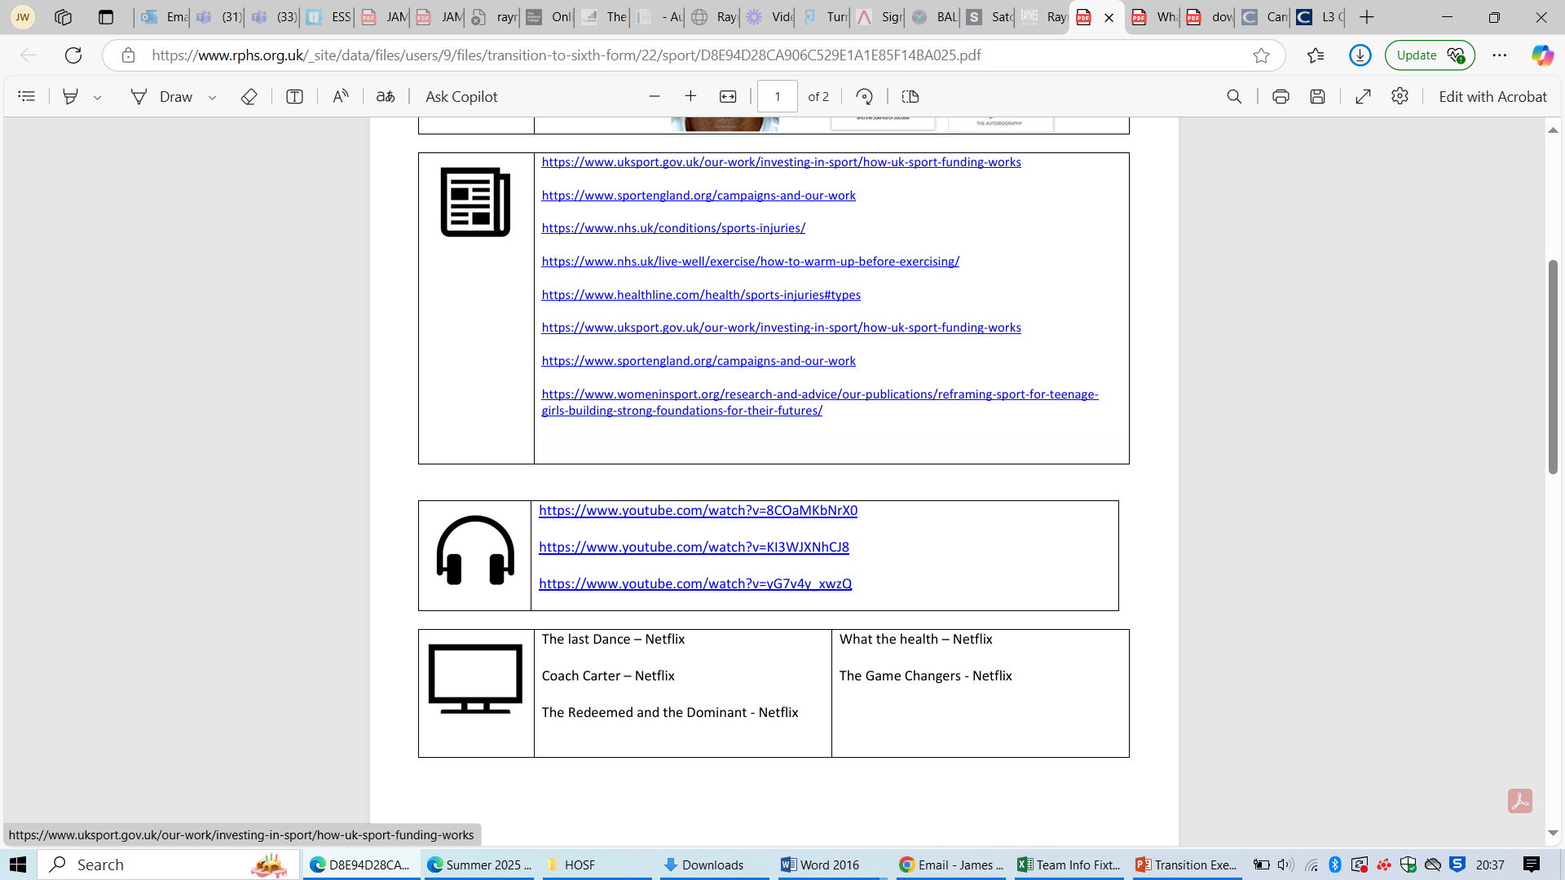
Btec National L3 Extended Certificate in 3D Art & Design – Pearson’s
It is essential that you complete the tasks within this transition document and present them to your class teacher in your first lesson at the start of the new academic year. These tasks will support your understanding of key concepts that you will be tested on in the induction assessments, taken within the first 3 weeks, that ultimately decide if you are suitable to continue on this course.
Units/Topics | Supporting Links | Reading
Unit 13 - 3D Design, Materials, Techniques and Processes Exploring 3D design materials, techniques and processes. Applying 3D design materials, techniques and processes to a brief. | Unit Specification: https://qualifications.pearson.com/en/qualifications/btec-nationals/art-and-design-2016.html#%2Ftab-Extended-Certificate_1 Unit 13 - Zoomorphic/Visual resources}: https://uk.pinterest.com/lsmith11065/zoomorphic-design/ | Famous artists and designers: https://www.contemporaryartissue.com/the-ultimate-top-100-modern-contemporary-artists/
TASK 1: Create 10 sketches of objects you have collected to help practice your understanding of form. These could include: pine cones, conkers, seeds heads, leaf skeletons, shells, fossils, fish, cross sections of fruit, vegetables,, feathers, butterflies, skulls and skeletons etc. | TASK 2: Produce 20 photos of zoomorphic based objects. These must be your own photos and not ones taken form the internet. Present the photos on an A3 PowerPoint page and add some sketches based on the photos. | TASK 3: Create a spider diagram based on the theme Zoomorphic Write a paragraph explaining what Zoomorphic is and how you perceive it meaning.
Know your why – Why {Enter your subject here}?
https://nationalcareers.service.gov.uk/explore-careers/job-sector/creative-and-design
Further Research | https://www.artsy.net/gene/zoomorphism https://en.wikipedia.org/wiki/Zoomorphism | Further Listening | Please find the following Podcast that will help deepen your knowledge of design: Talking D&T Better Design Design Matters | Further Watching | https://www.youtube.com/watch?v=bjEw-mulcjA https://www.youtube.com/watch?v=FLrCO4K2Wkw

